Slide 1
GC1_LIM food web

Slide 2
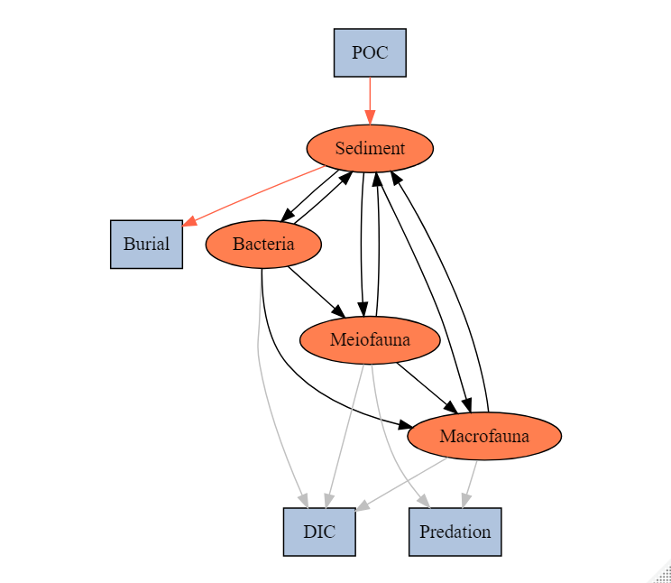
Topological food web structure
SYM | MEANING
POC->SED | Organic matter derived from the water column
SED->EXP_S | Sediment export(e.g. downslope, burial…)
SED->BAC | Bacteria feed on detritus OC
BAC->SED | Bacteria feces deposit on sediment
SED->MEI | Meiofauna feed on detritus OC
MEI->SED | Meiofauna feces deposit on sediment
SED->MAC | Macrofauna feed on detritus OC
MAC->SED | Macrofauna feces deposit on sediment
BAC->MEI | Meiofauna feed on bacteria
BAC->MAC | Macrofauna feed on bacteria
MEI->MAC | Macrofauna feed on meiofauna
MEI->EXP_B | Meiofauna predated by other benthopelagic/pelagic predators
MAC->EXP_B | Macrofauna predated by other benthopelagic/pelagic predators
BAC->DIC | Bacteria respiration
MEI->DIC | Meiofauna respiration
MAC->DIC | Macrofauna respiration
abiotic
biotic
Internal flows
Exchange with external

Slide 3
Compartment | Standing stock (mgC m⁻²)
Detritus | 2504.94
Bacteria | 4.62
Meiofauna | 0.69
Macrofauna | 3.65
Problem 1
Sampling season
Cruise | OR1_1096 | OR1_1099 | OR1_1102 | OR1_1114 | OR1_1126 | OR1_1128 | OR1_1151 | OR1_1190
Date | 2014/11 | 2015/03 | 2015/04 | 2015/08 | 2015/11 | 2016/02 | 2016/10 | 2018/03-04
Detritus | √ | √ | √ | √ | √ | √ | √ | √
Bacteria |  |  |  |  |  |  |  | √
Meiofauna |  |  |  | √ | √ | √
Macrofauna | √ | √ | √ | √ | √ | √ | √ | √

Slide 4
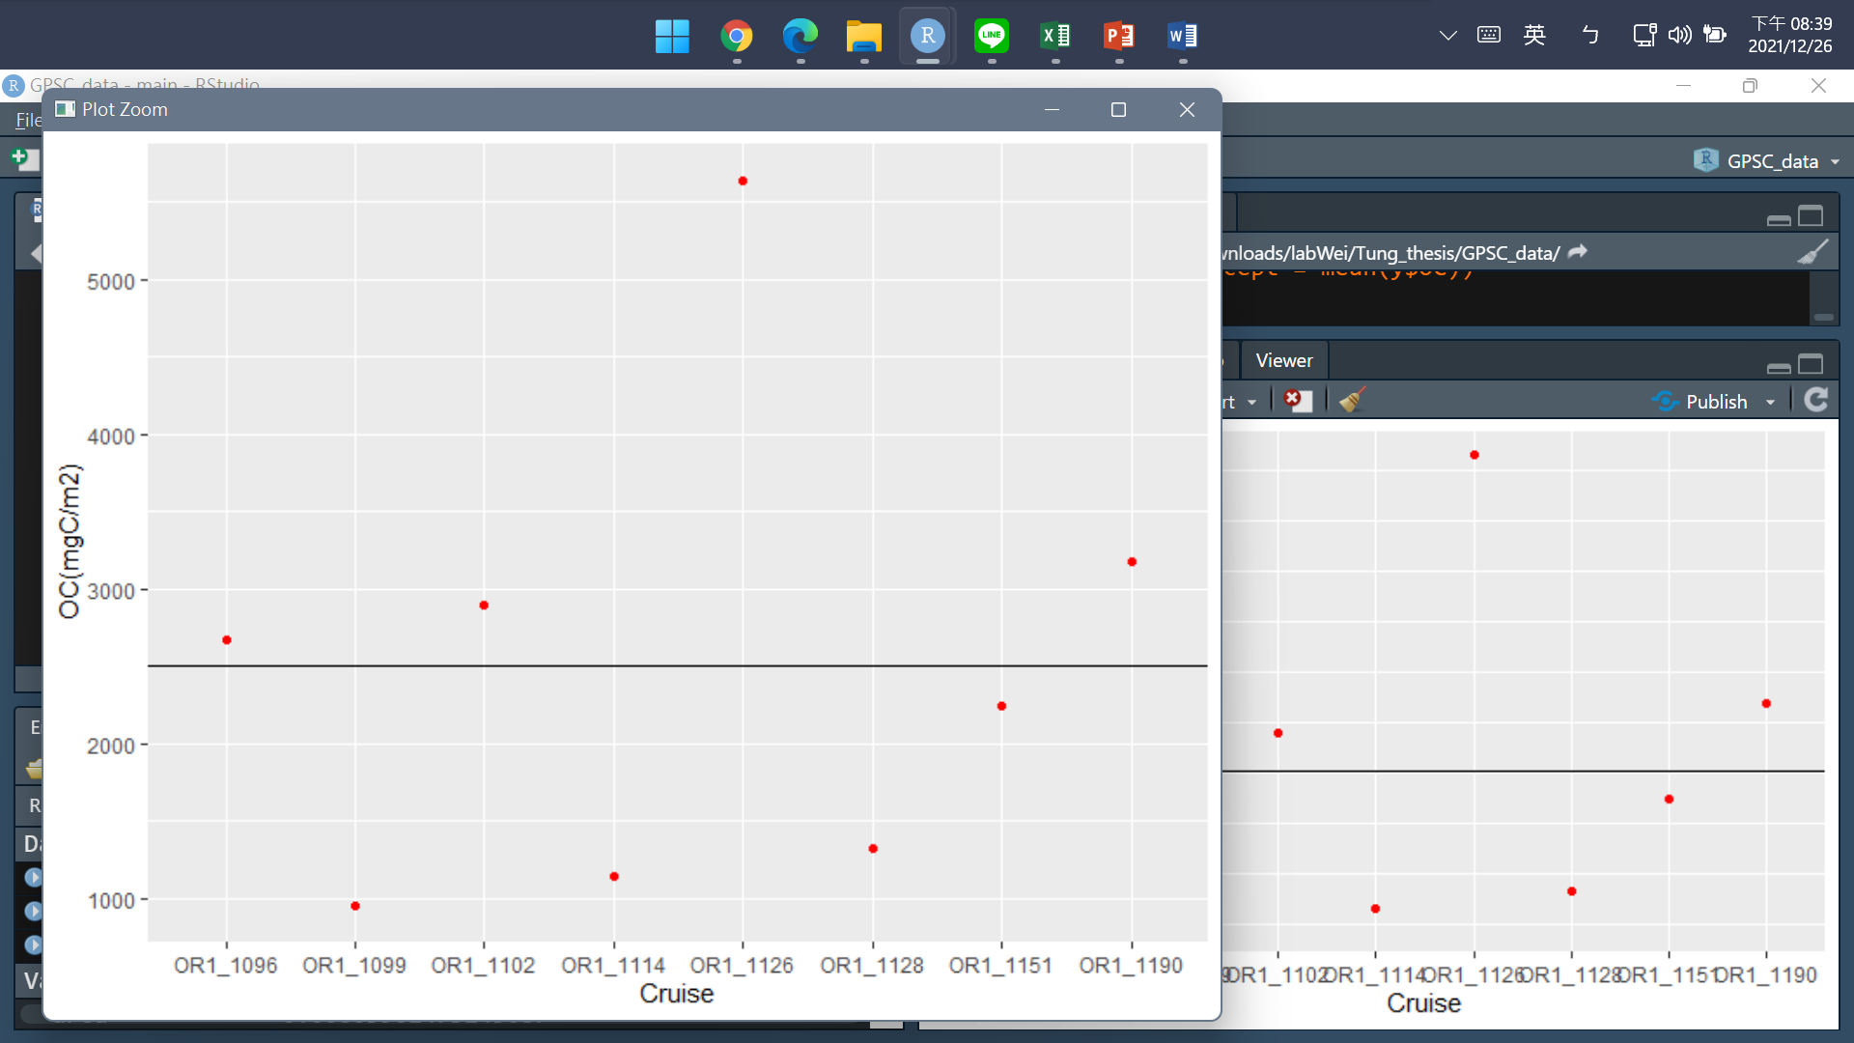
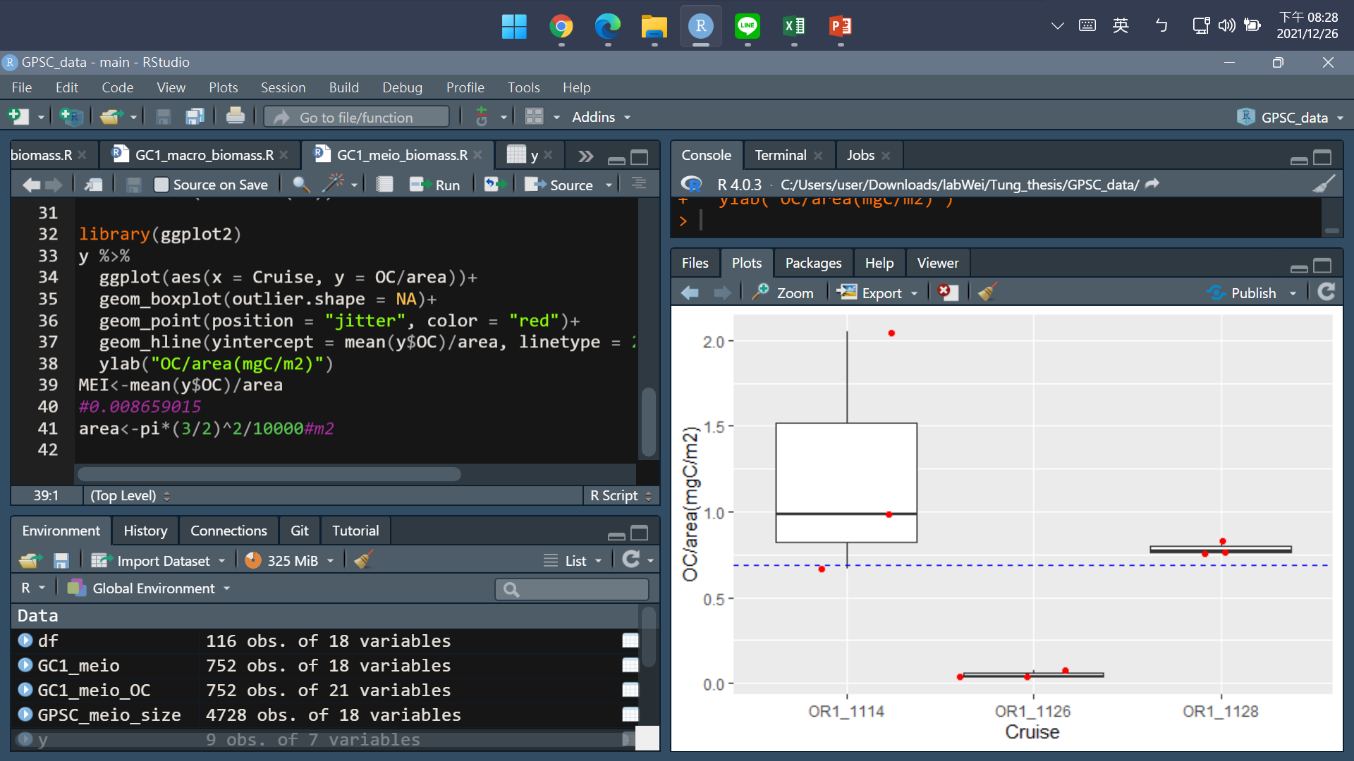
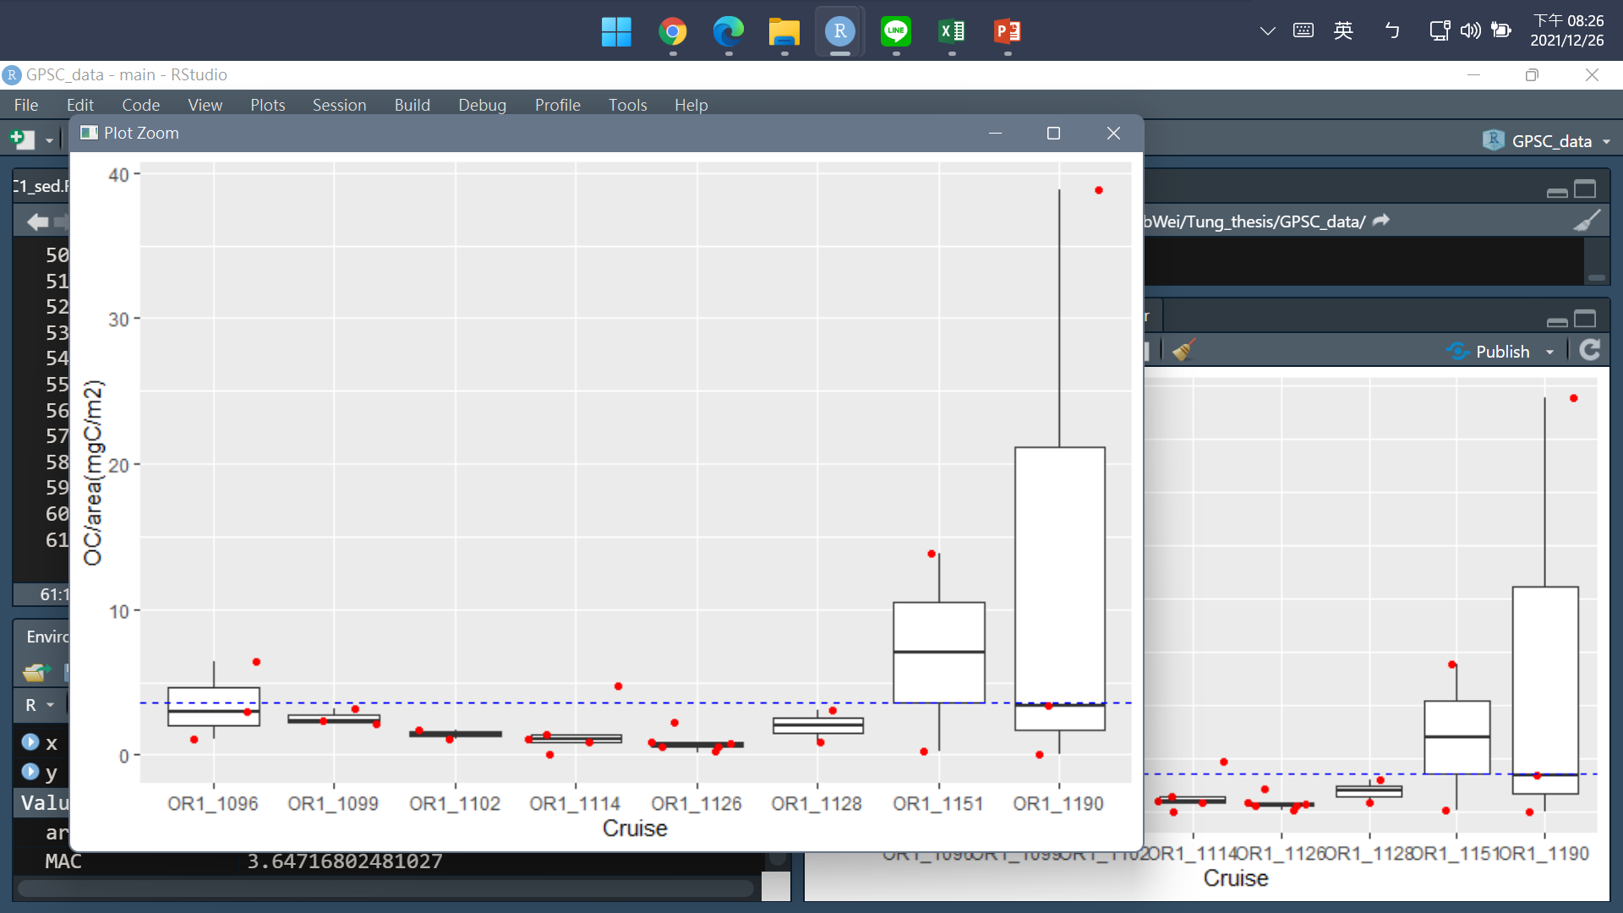
Detritus
Meiofauna
Macrofauna
Problem 3
Should foraminifera be included?

Slide 5
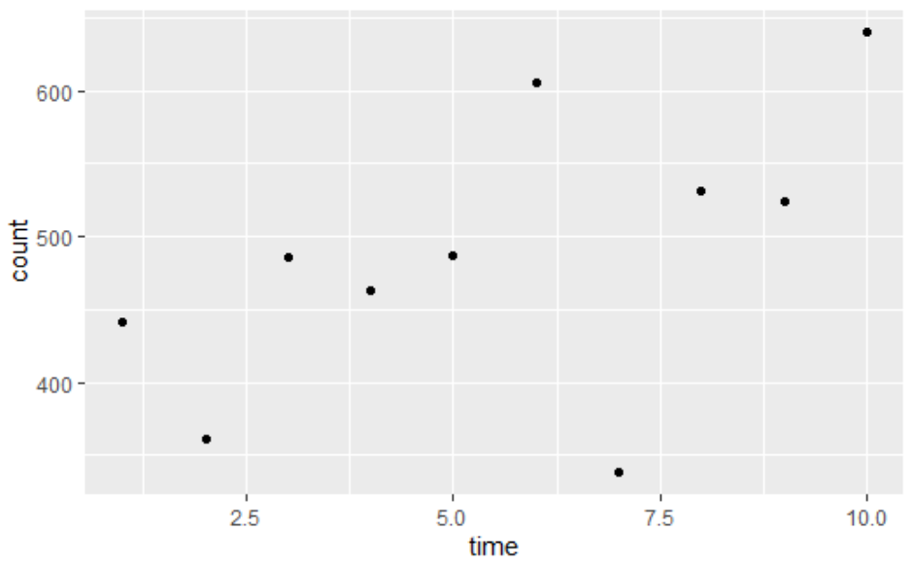
Bacteria
Code:
A<-9^2*pi #well area (mm^2)
a<-0.11^2*pi #view area (mm^2)
V<-0.1/2 #sample volume (ml)
GC1_bac_num <- mean(GC1_bac_count*A/a/V)
#count* A/a/V = # bac/ ml
area<-pi*(3/2)^2/10000#m2
# Convert to biomass (assuming 10 fgC cell-1, Deming & Capenter 2008)
GC1_bac_biomass<-GC1_bac_num*10*V/1E-12/area #fgC/ml*V(ml)/core area(m2)/1E-12=mgC/m2
Problem 2
Vertical sediment depth:
For meio & bac: quantity/syringe area; ignored depth?
For detritus: 0-1 cm
For macro: 0-10 cm

Slide 6
12/27 discussion record
1. Carbon calculation
Sediment: 體積*密度*TOC(%)/core area
Bactieria: #bac/ml(cm3)*(10)cm->換算成m2
Meio/macro: assume all fauna within 5cm/10cm of sediment have been already included (mgC/core(or syringe) area
For macrofauna, carefully remove the outlier
No need: Foraminefera
2. find POC and sedimentation rate (James T.Liu/Chih-An Huh…
3. Seasonal difference
mean model
fall model
spring model
4. figure out respiaration (maybe use 2 models to compare)
measured data
allometric estimation

Slide 7
Available data
autumn
spring
summer
GC1
Cruise | NOR_T004 | OR1_1096 | OR1_1099 | OR1_1102 | OR1_1114 | OR1_1126 | OR1_1128 | OR1_1151 | OR1_1190 | OR1_1219 | OR1_1242
Date | 2020/11 | 2014/11 | 2015/03 | 2015/04 | 2015/08 | 2015/11 | 2016/02 | 2016/10 | 2018/03-4 | 2019/03-4 | 2019/10
Detritus | √ | √ | √ | √ | √ | √ | √ | √ | √ | √ | √
Bacteria |  |  |  |  |  |  |  |  | √
Meiofauna |  |  |  |  | √ | √ | √
Macrofauna |  | √ | √ | √ | √ | √ | √ | √ | √
TOU | √ |  |  |  |  |  | √ | √ | √ | √ | √
DOU | √ |  |  |  |  | √ | √ | √ | √ | √ | √
GS1
Detritus |  | √ | √ | √ | √ | √ |  | √ | √ | √ | √
Bacteria |  |  |  |  |  |  |  |  | √
Meiofauna
Macrofauna
TOU |  |  |  |  | √ | √ |  |  | √ | √ | √
DOU |  |  |  |  |  | √ |  | √ | √ | √ | √

Slide 8
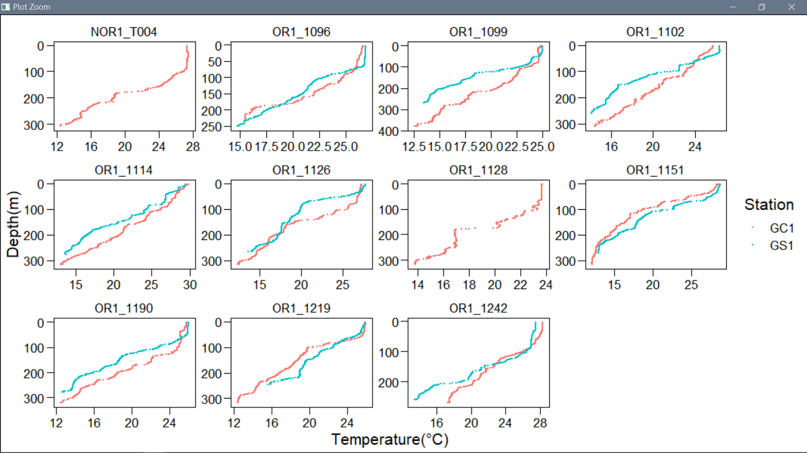
Available data_CTD

Slide 9
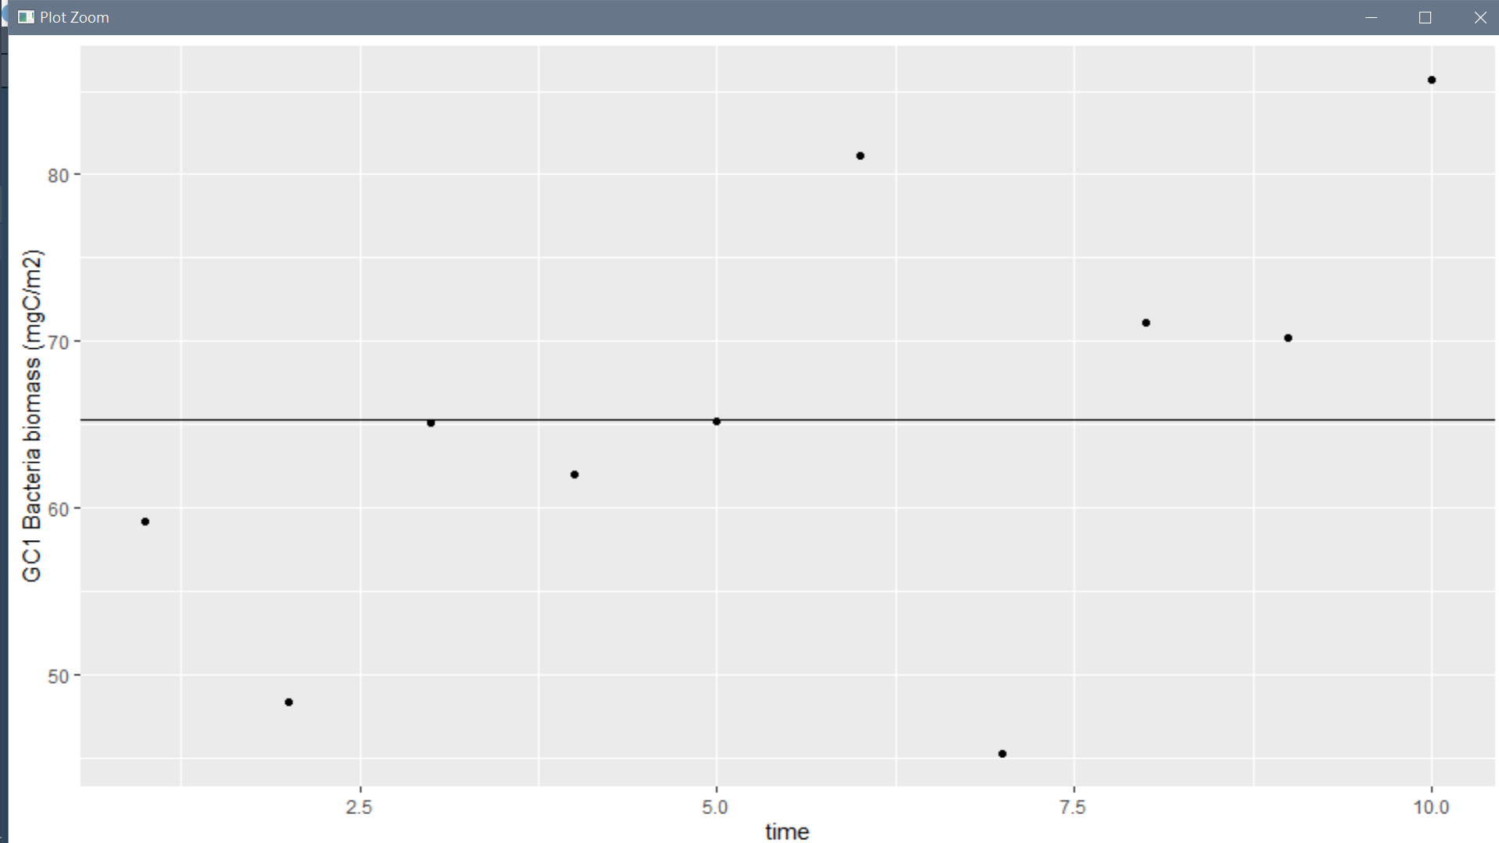
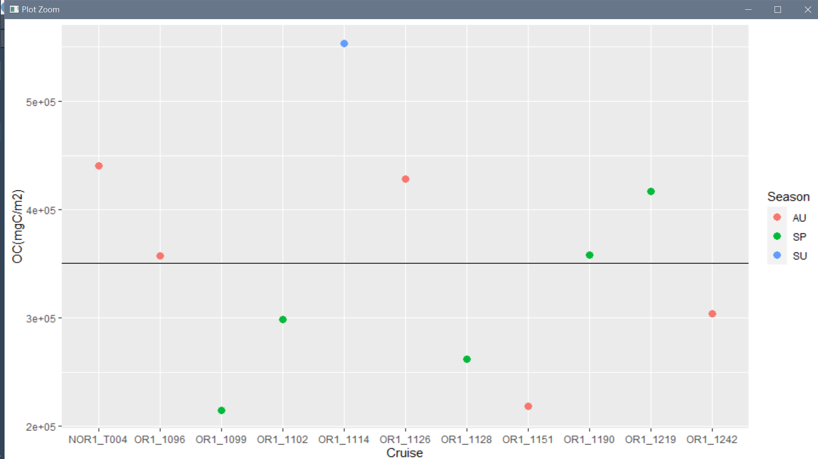
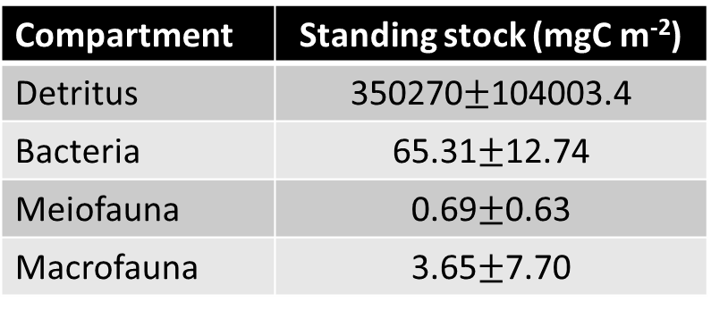
GC1 (revised)
Steps to calculate bactieria :
#bac/ml(cm3)*(10)cm-> mgC/m2
Steps to calculate detritus OC:
Calculate volume (core area * 10cm)
Volume*density*TOC(%) -> mgC/m2
Section types (2):
0-1 cm only -> *10
(0-1)+(1-2)+(2-3)+(3-4)+(4-5)+5*(9-10)
Define season
Final used stock:
Compartment | Standing stock (mgC m⁻²)
Detritus | 350270$±$104003.4
Bacteria | 65.31$±$12.74
Meiofauna | 0.69$±$0.63
Macrofauna | 3.65$±$7.70

Slide 10
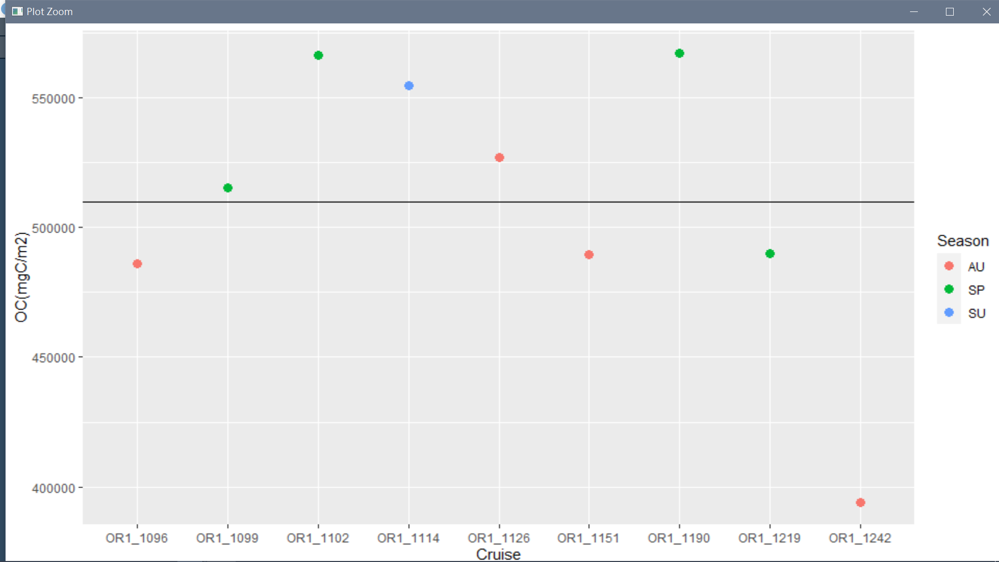
GS1
outlier + only 0-1 cm-> remove

Slide 11
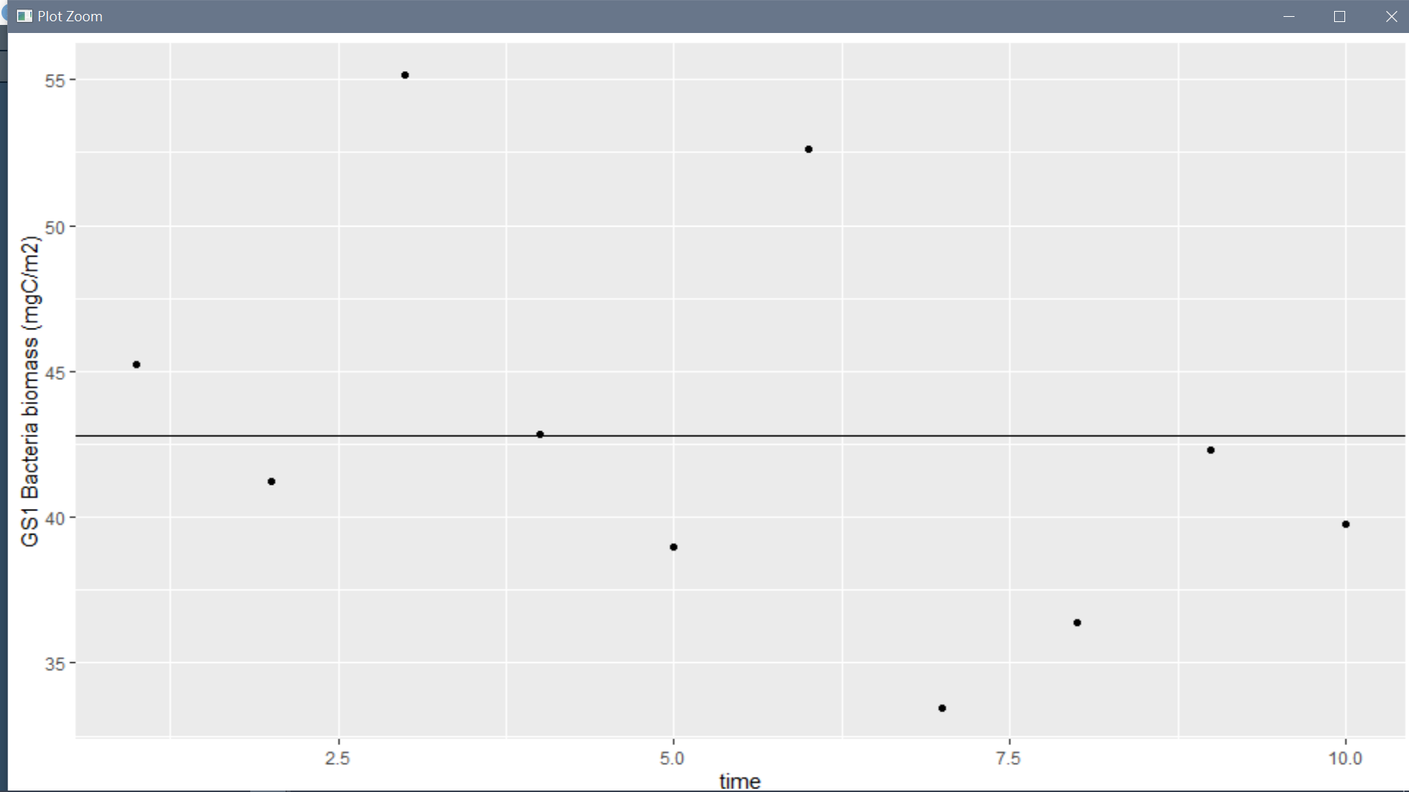
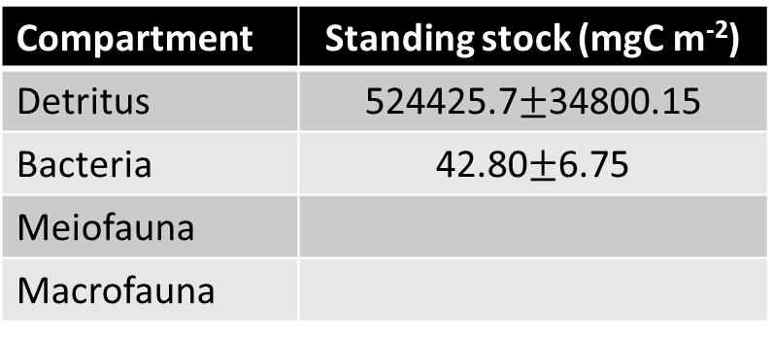
Compartment | Standing stock (mgC m⁻²)
Detritus | 524425.7$±$34800.15
Bacteria | 42.80$±$6.75
Meiofauna
Macrofauna

Slide 12
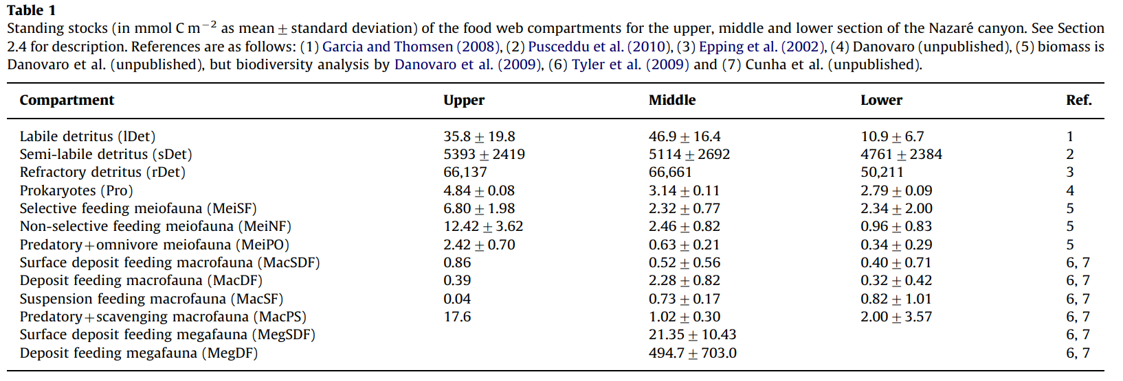
Comparison: Data from van Oevelen et al.(2011) in Nazare canyon
1mol C =12g C
mg C/m2
429.6
64716
793644
58.08
81.6
149.04
29.04
10.32
4.68
0.48
211.2
Compartment | Standing stock (mgC m⁻²)
Detritus | 858,789.6
Bacteria | 58.08
Meiofauna | 259.68
Macrofauna | 226.68

Slide 13
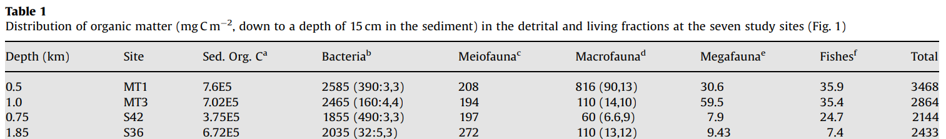
Comparison: Data from Rowe et al. (2008) in Gulf of Mexico
MT1: Mississippi canyon head
MT3: upper continental slope in the Mississippi Canyon
S36 : deep continental slope in the DeSoto Canyon
MT1
MT3
Compartment | Standing stock (mgC m⁻²)
Detritus | 760000
Bacteria | 2585
Meiofauna | 208
Macrofauna | 816
Compartment | Standing stock (mgC m⁻²)
Detritus | 702000
Bacteria | 2465
Meiofauna | 194
Macrofauna | 110

Slide 14
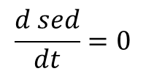
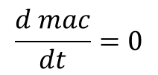
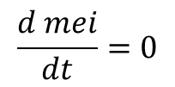
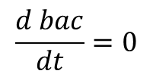
Ax=b
Mass conservation
abiotic
$$\frac{d sed}{dt}=0$$
biotic
$$\frac{d bac}{dt}=0$$
$$\frac{d mei}{dt}=0$$
$$\frac{d mac}{dt}=0$$
Internal flows
Exchange with external

Slide 15
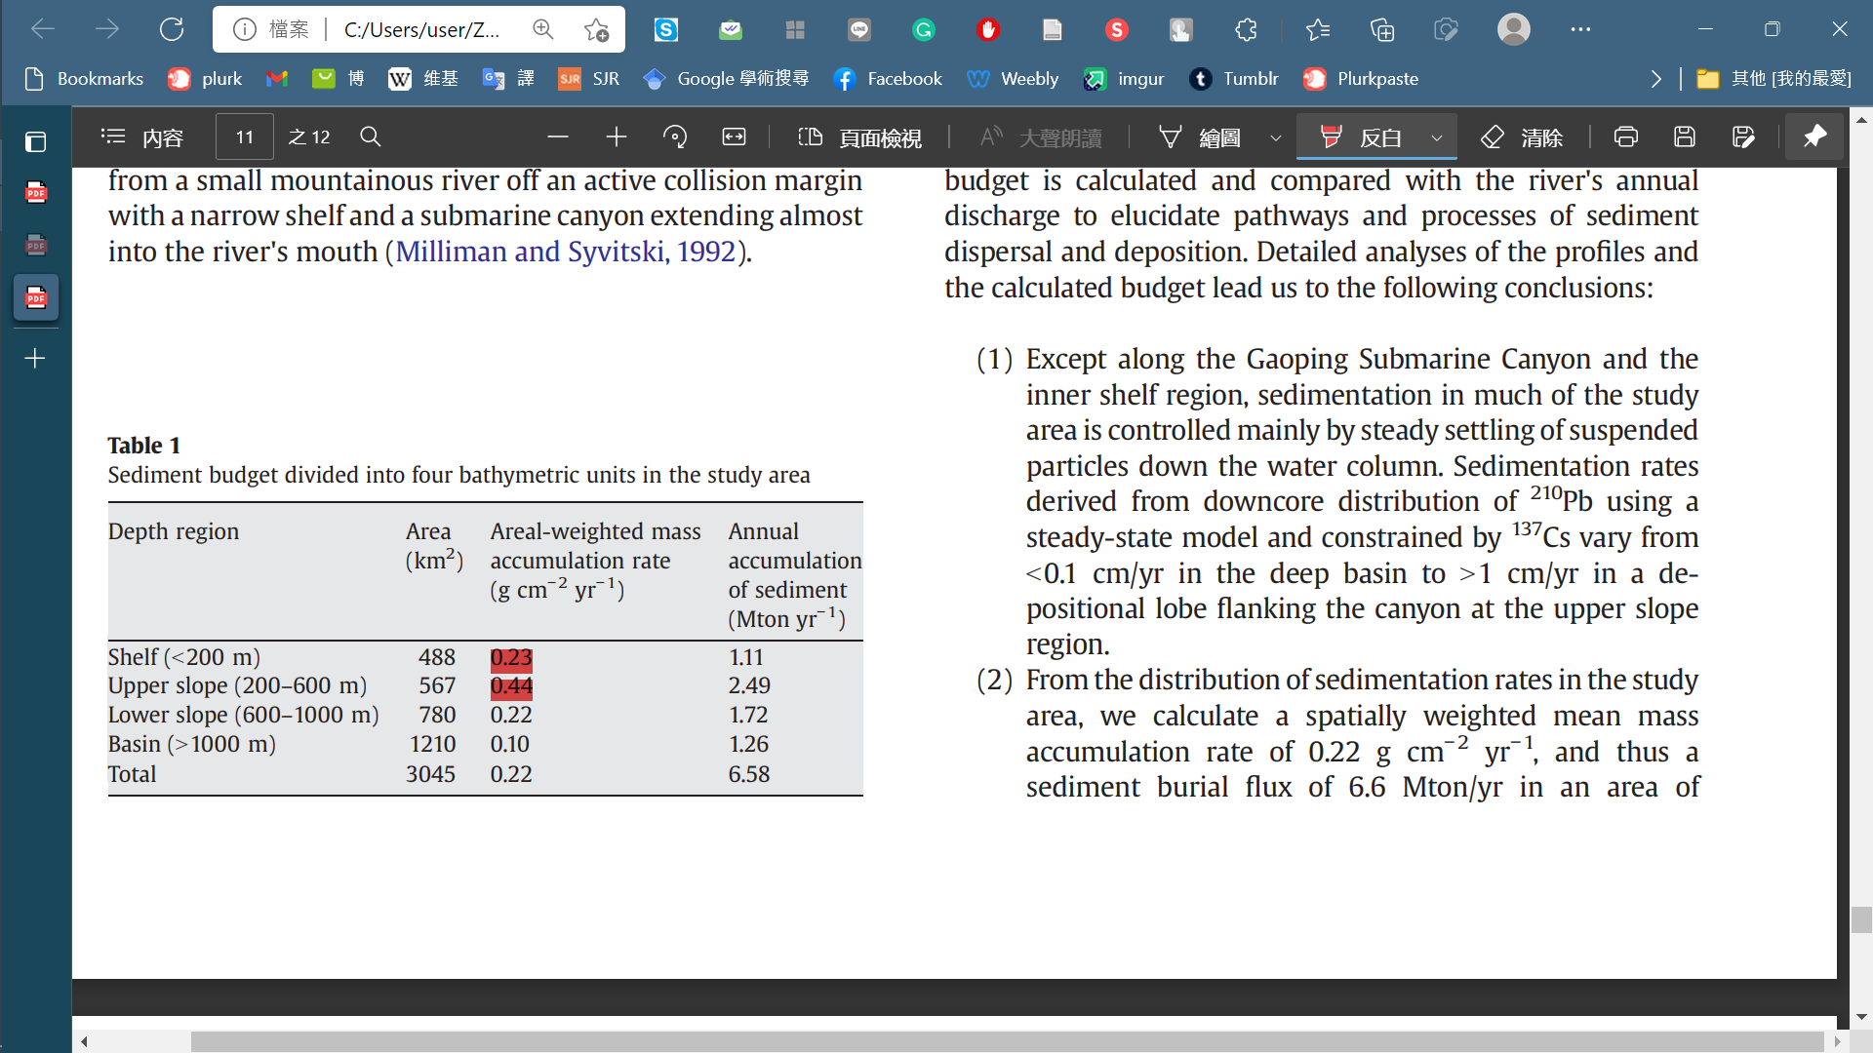
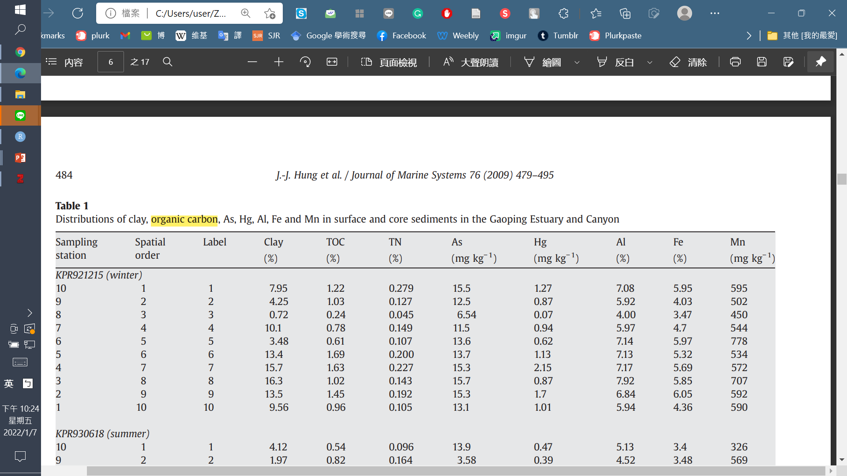
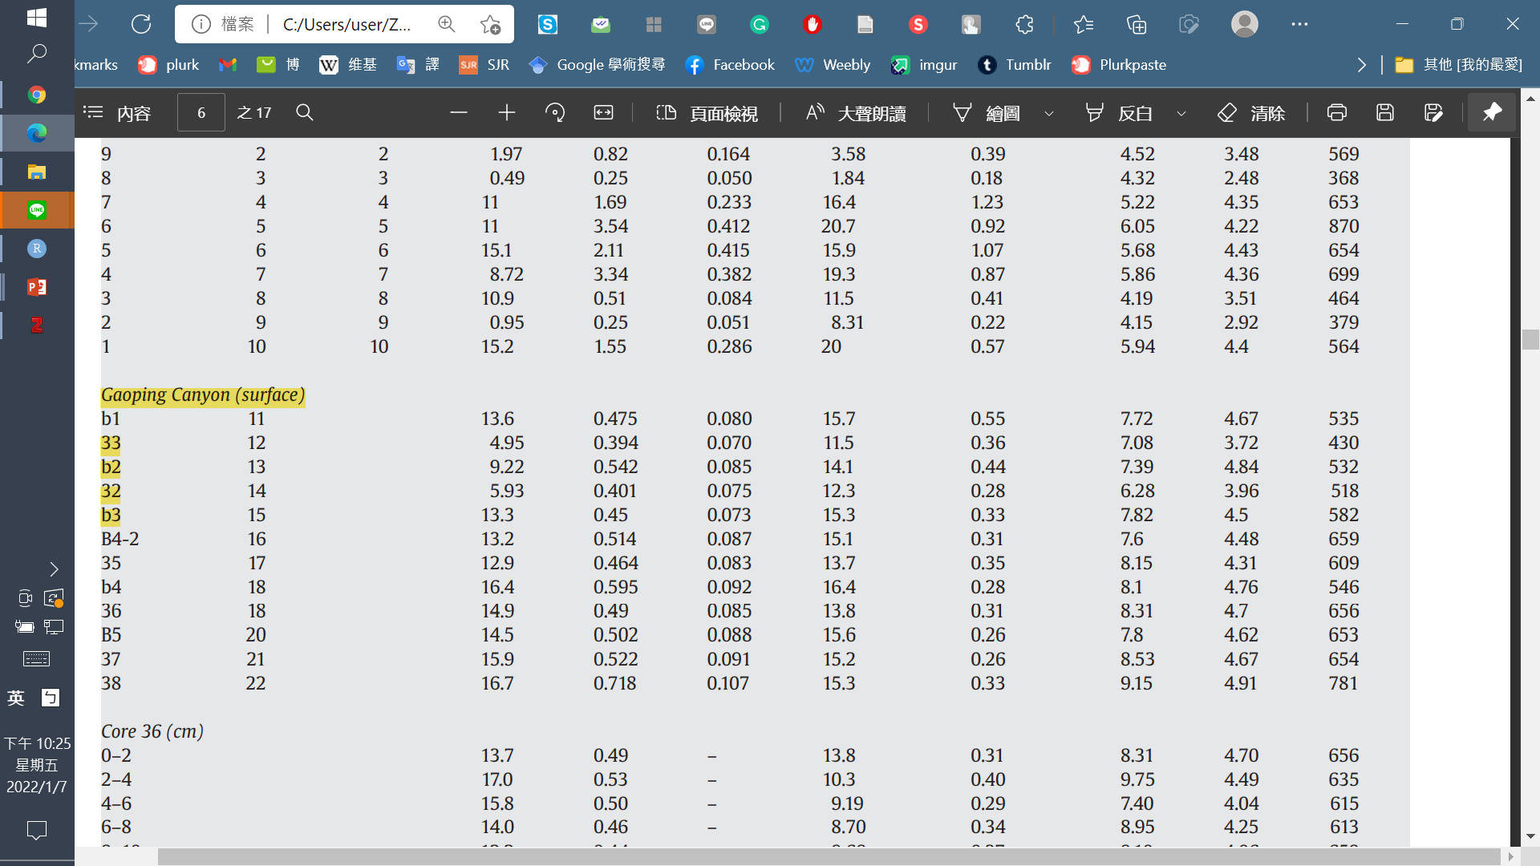
Ex=f
Huh et al (2009)
POC->SED
12054.79* 0.44675 % = 53.85 mg/m2/d
0.44 g/cm2/yr -> 12054.79 mg/m2/d
The head of GPSC is deeply incised into the continental shelf (i.e.,vertical relief>400 m)
Hung et al (2009)
Comparison:
MT1: 77.7 mgC/m2/d (Rowe et al. 2008)
Nazare canyon (upper): Carbon deposition from water column/ MacSF: 11.52-112.8 mgC/m2/d(van Oevelen et al. 2011)
0.44675%

Slide 16
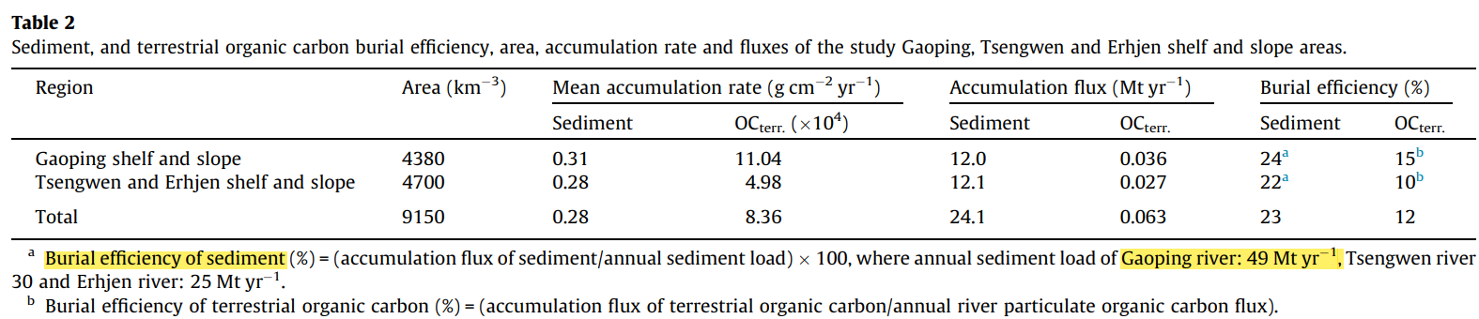
Ex=f
SED->EXP_S=0.24*POC->SED
Hsu et al. (2014)

Slide 17
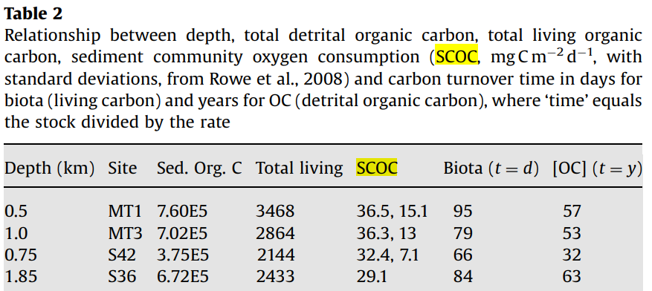
Ex=f
BAC->DIC
MEI->DIC
MAC->DIC
SCOC (TOU)
DOU
BMU
Comparison (Rowe et al. 2008)
MT1: 36.5 mg C/m2/d
MT3: 36.3 mg C/m2/d
TOU:
benthos' respiration and the benthos-mediated oxygen utilization through their activities
DOU:
mainly contributed by aerobic respiration of microorganisms through slow diffusion of oxygen molecules
BMU:
benthos-mediated oxygen utilization, characterizing benthos' contribution to sediment oxygen dynamics

Slide 18
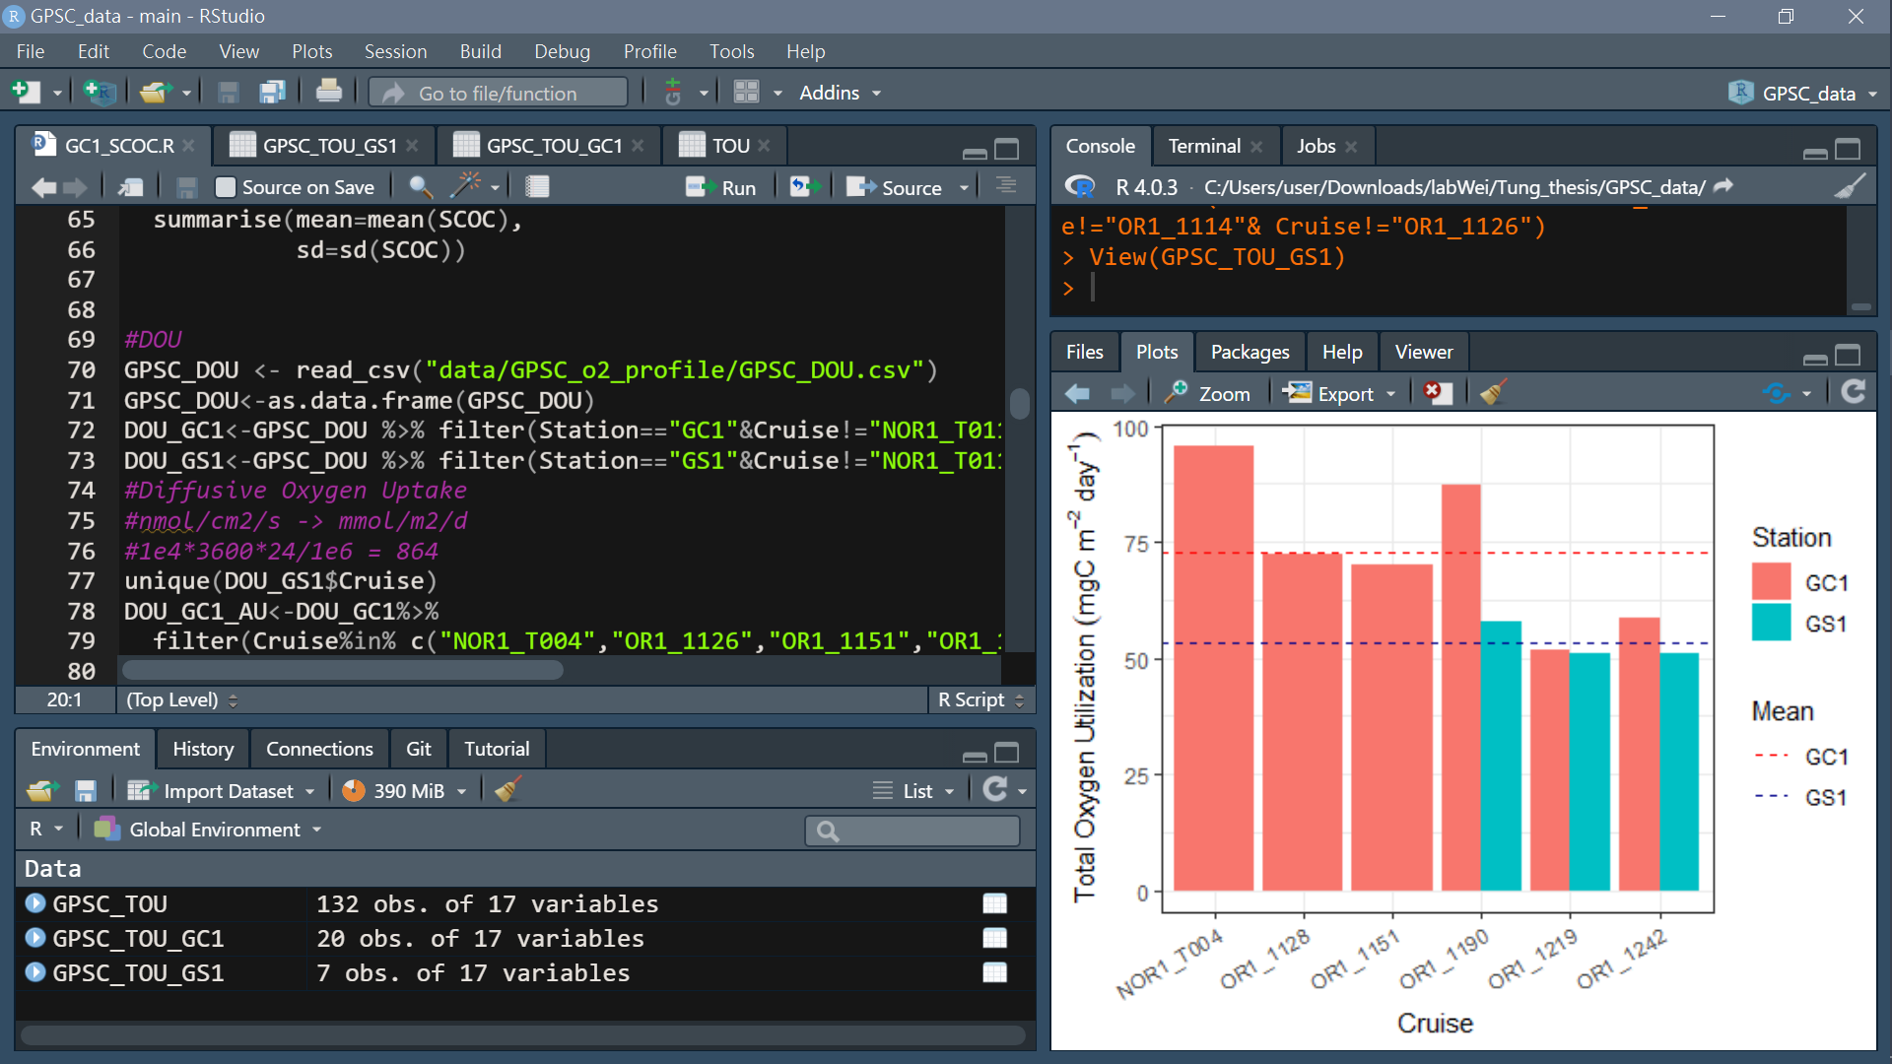
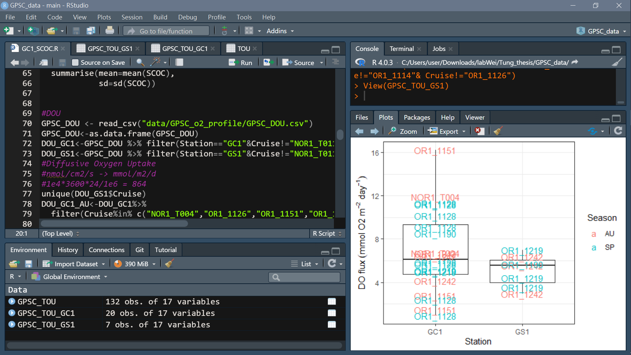
Ex=f
Data collected from ship-board incubation:
DO measured until the concentrations decreased by 15% of the initial concentration
The fluxes of oxygen unit: (mmol/m2/day) (Change in concentration x Volume of overlying water) / (Core area x Time])
mmolO2 -> mgO2: 33.191 mgO2/mmolO2
mgO2 -> mgC: 0.309 mgC/mgO2
SCOC (TOU)
Station | Mean TOU (mgC/m2/d) | sd TOU (mgC/m2/d)
GC1 | 72.58901 | 16.603905
GS1 | 53.37575 | 4.061608
*Remove GS1 of OR1_1114 & OR1_1126 outlier (1 core only and outlier)

Slide 19
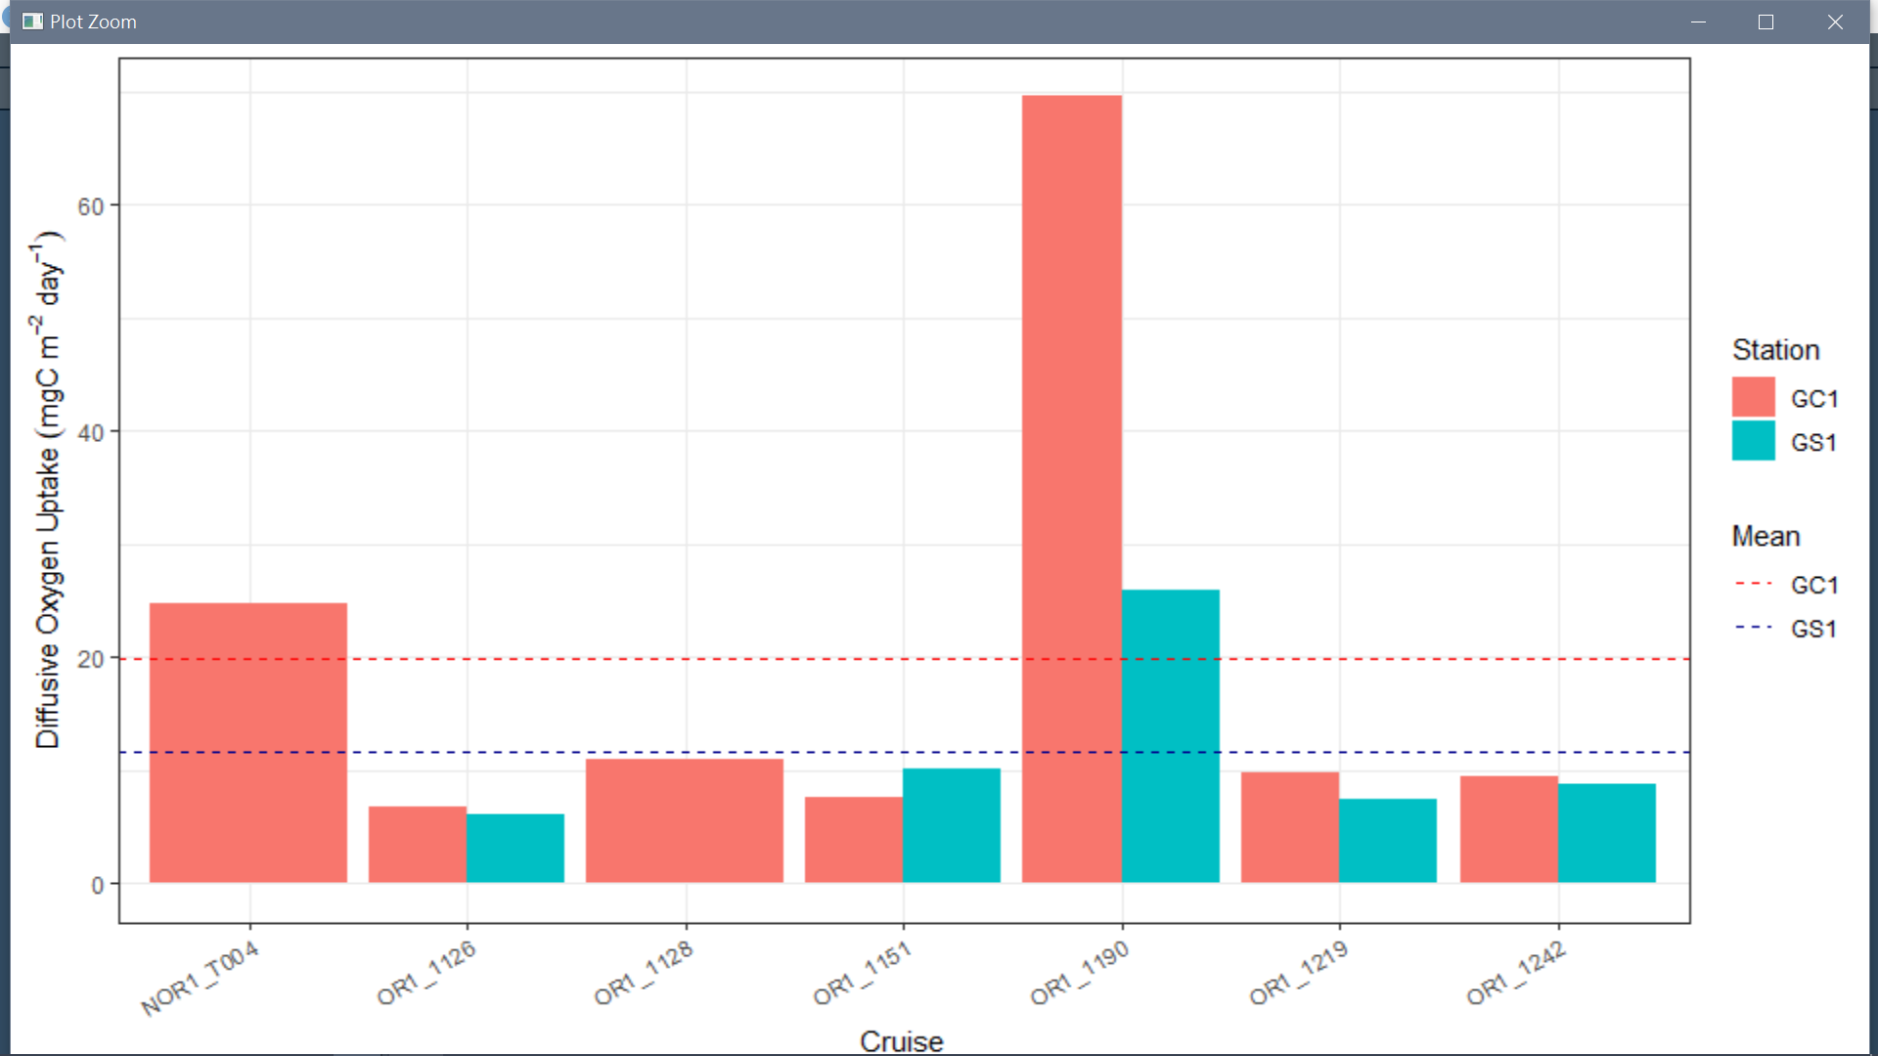
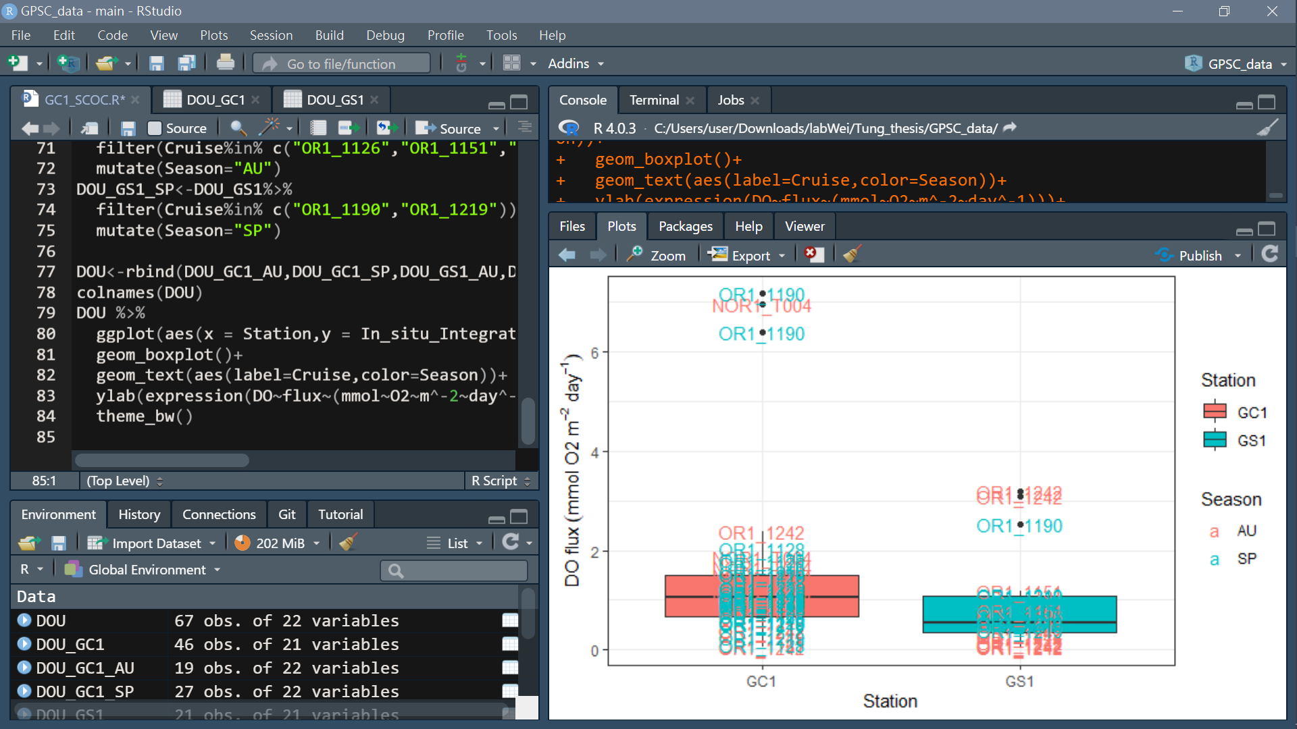
Ex=f
After the shipboard incubation
Unisense® Field Microprofiling System measure the sediment oxygen profile concentrations
DOU
Station | Mean DOU (mgC/m2/d) | sd DOU (mgC/m2/d)
GC1 | 19.80919 | 22.72966
GS1 | 11.67663 | 8.148866

Slide 20
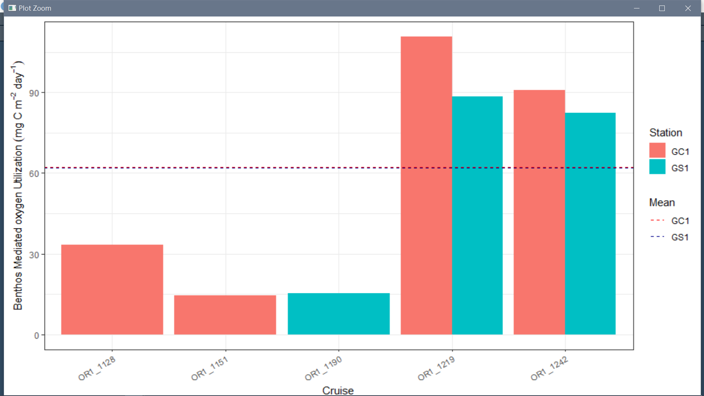
Ex=f
Station | Mean BMU (mgC/m2/d) | sd BMU (mgC/m2/d)
GC1 | 62.34343 | 45.86694
GS1 | 62.01101 | 40.56152
BMU

Slide 21
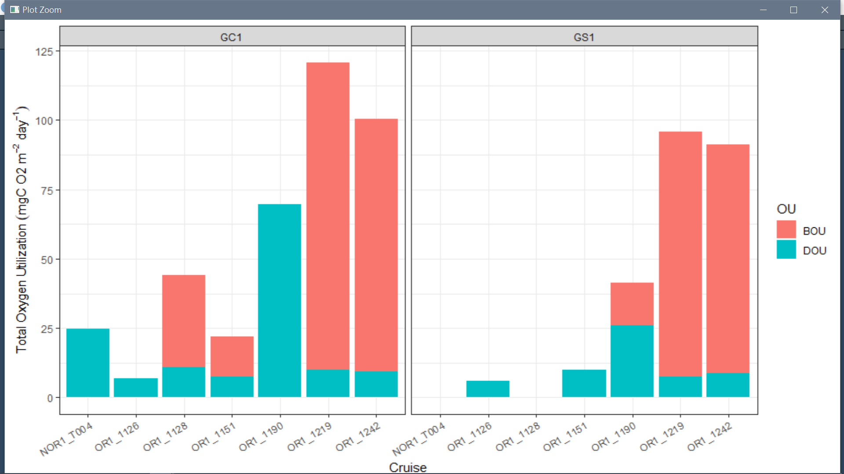
Ex=f
Summary

Slide 22
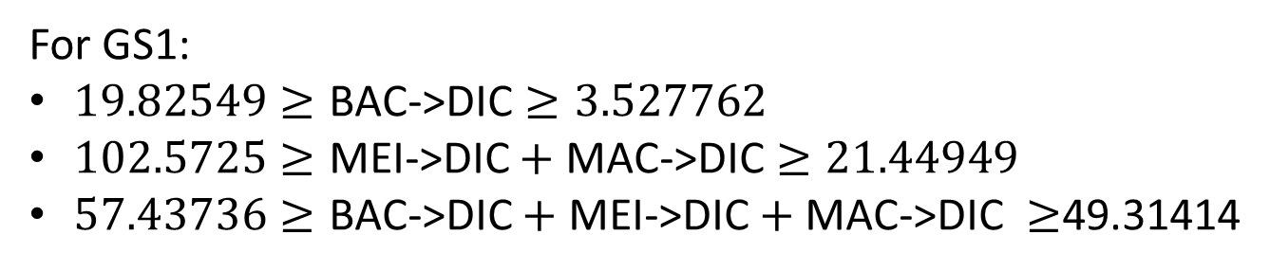
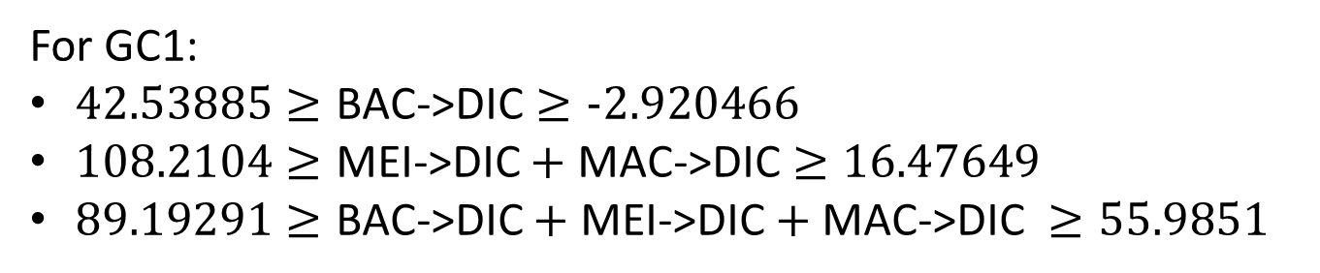
Ex=f
In situ data of Oxygen Utilization
For GC1:
$42.53885≥\text{BAC}\text{−>}\text{DIC}≥−2.920466$
$108.2104≥\text{MEI}\text{−>}\text{DIC}+\text{MAC}\text{−>}\text{DIC}≥16.47649$
$89.19291≥\text{BAC}\text{−>}\text{DIC}+\text{MEI}\text{−>}\text{DIC}+\text{MAC}\text{−>}\text{DIC} ≥55.9851$
For GS1:
$19.82549≥\text{BAC}\text{−>}\text{DIC}≥3.527762$
$102.5725≥\text{MEI}\text{−>}\text{DIC}+\text{MAC}\text{−>}\text{DIC}≥21.44949$
$57.43736≥\text{BAC}\text{−>}\text{DIC}+\text{MEI}\text{−>}\text{DIC}+\text{MAC}\text{−>}\text{DIC} ≥$49.31414
In situ data of Oxygen Utilization

Slide 23
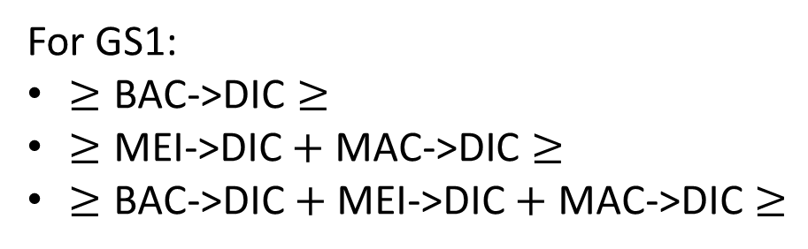
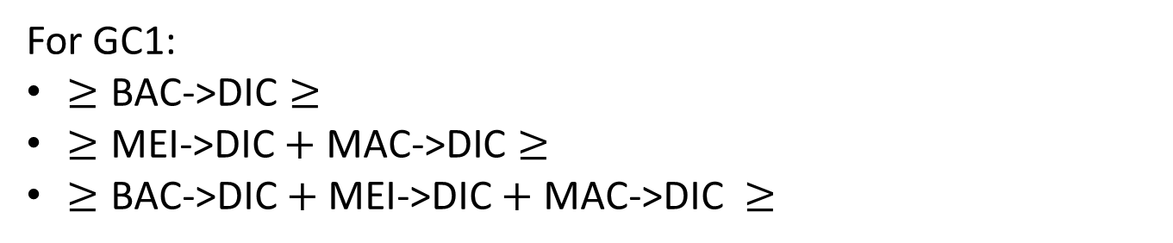
Ex=f
Maintenance respiration
For GC1:
$≥\text{BAC}\text{−>}\text{DIC}≥$
$≥\text{MEI}\text{−>}\text{DIC}+\text{MAC}\text{−>}\text{DIC}≥$
$≥\text{BAC}\text{−>}\text{DIC}+\text{MEI}\text{−>}\text{DIC}+\text{MAC}\text{−>}\text{DIC} ≥$
For GS1:
$≥\text{BAC}\text{−>}\text{DIC}≥$
$≥\text{MEI}\text{−>}\text{DIC}+\text{MAC}\text{−>}\text{DIC}≥$
$≥\text{BAC}\text{−>}\text{DIC}+\text{MEI}\text{−>}\text{DIC}+\text{MAC}\text{−>}\text{DIC}≥$

Slide 24
Dealing with respiration problem
LSEI error: inequalities contradictory
Using equalities and/or inequalities that are incompatible.
eg.: I want that a > 10 but also that a < 2
Directly use measured TOU data
Calculated based on allometric relationships and temp (Mahaut et al 1995)
LSEI error
Only assume maintenance respiration
(van Oevelen)
Successfully run
Use speculated respiration rate
Compare results

Slide 25
Dealing with respiration problem
Calculated based on allometric relationships and temp (Mahaut et al 1995)
Weight-dependent respiration rates:
BIO->DIC (R) = 7.4*10^-3*Stock(W)^(-0.24)
! Exponential function is not allowed in LIM.input file, so R is calculated base on the initial stock (this is not a dynamic model)
temperature limitation factor
Maintenance Respiration(mr)= Tlim * 0.01 * STOCK
Maintenance costs are taken proportional to 1% of the biomass per day (Fenchel, 1982; Nielsen et al., 1995)
Growth respiration(gr)= BIO->DIC-mr
Other processes
Assimilation efficiency (AE)= (Consumption-Defecation)/Consumption
Net growth efficiency (NGE)=(Consumption-Defecation-gr)/ (Consumption-Defecation)
(Consumption-Defecation-gr)/Stock= P/B ratio
Only assume maintenance respiration (MR)
(van Oevelen)
Use speculated respiration rate
BIO->DIC= biomass-specific faunal respiration rate (bsFR)*Stock

Slide 26
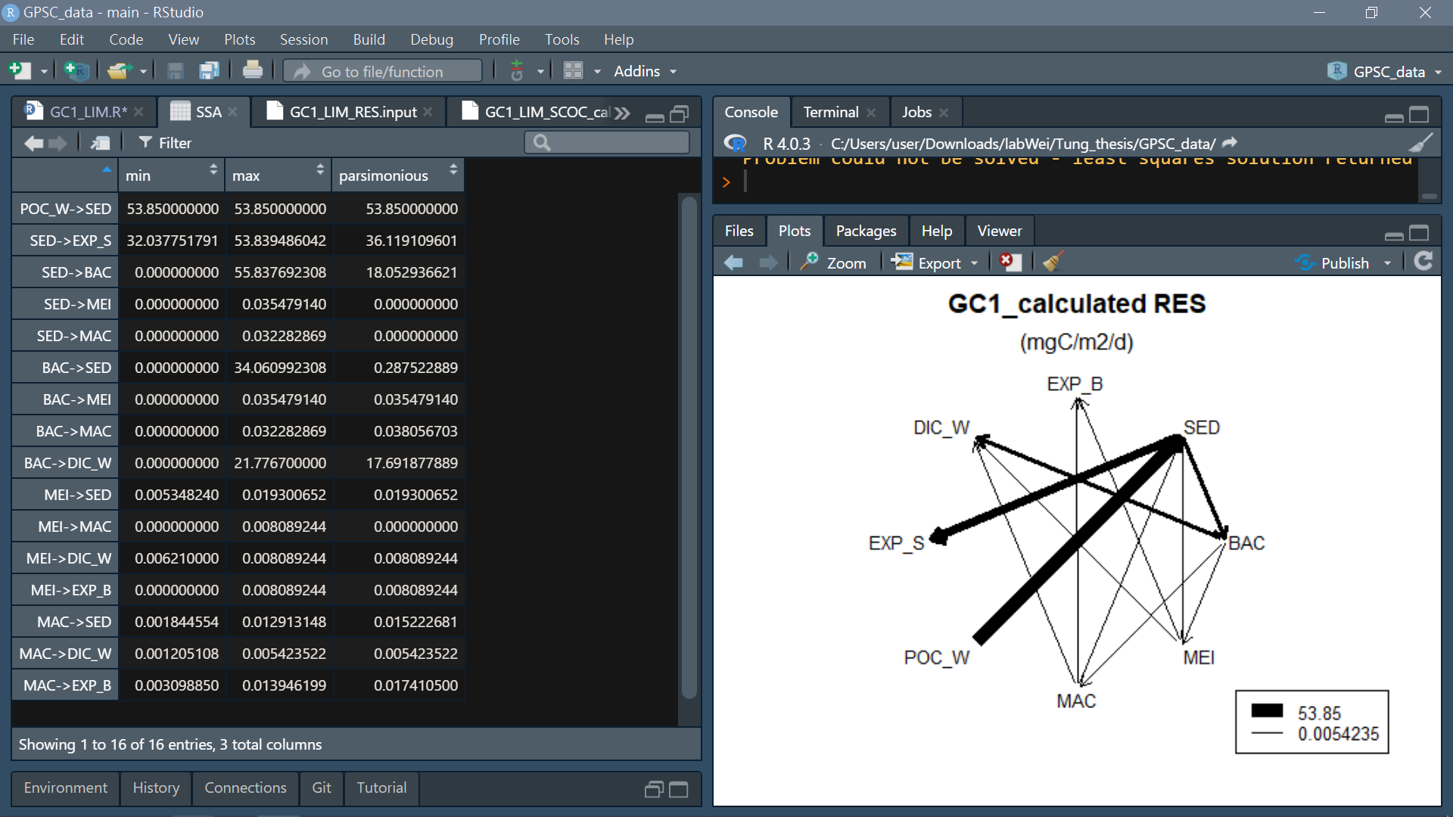
SSA Result:

Slide 27
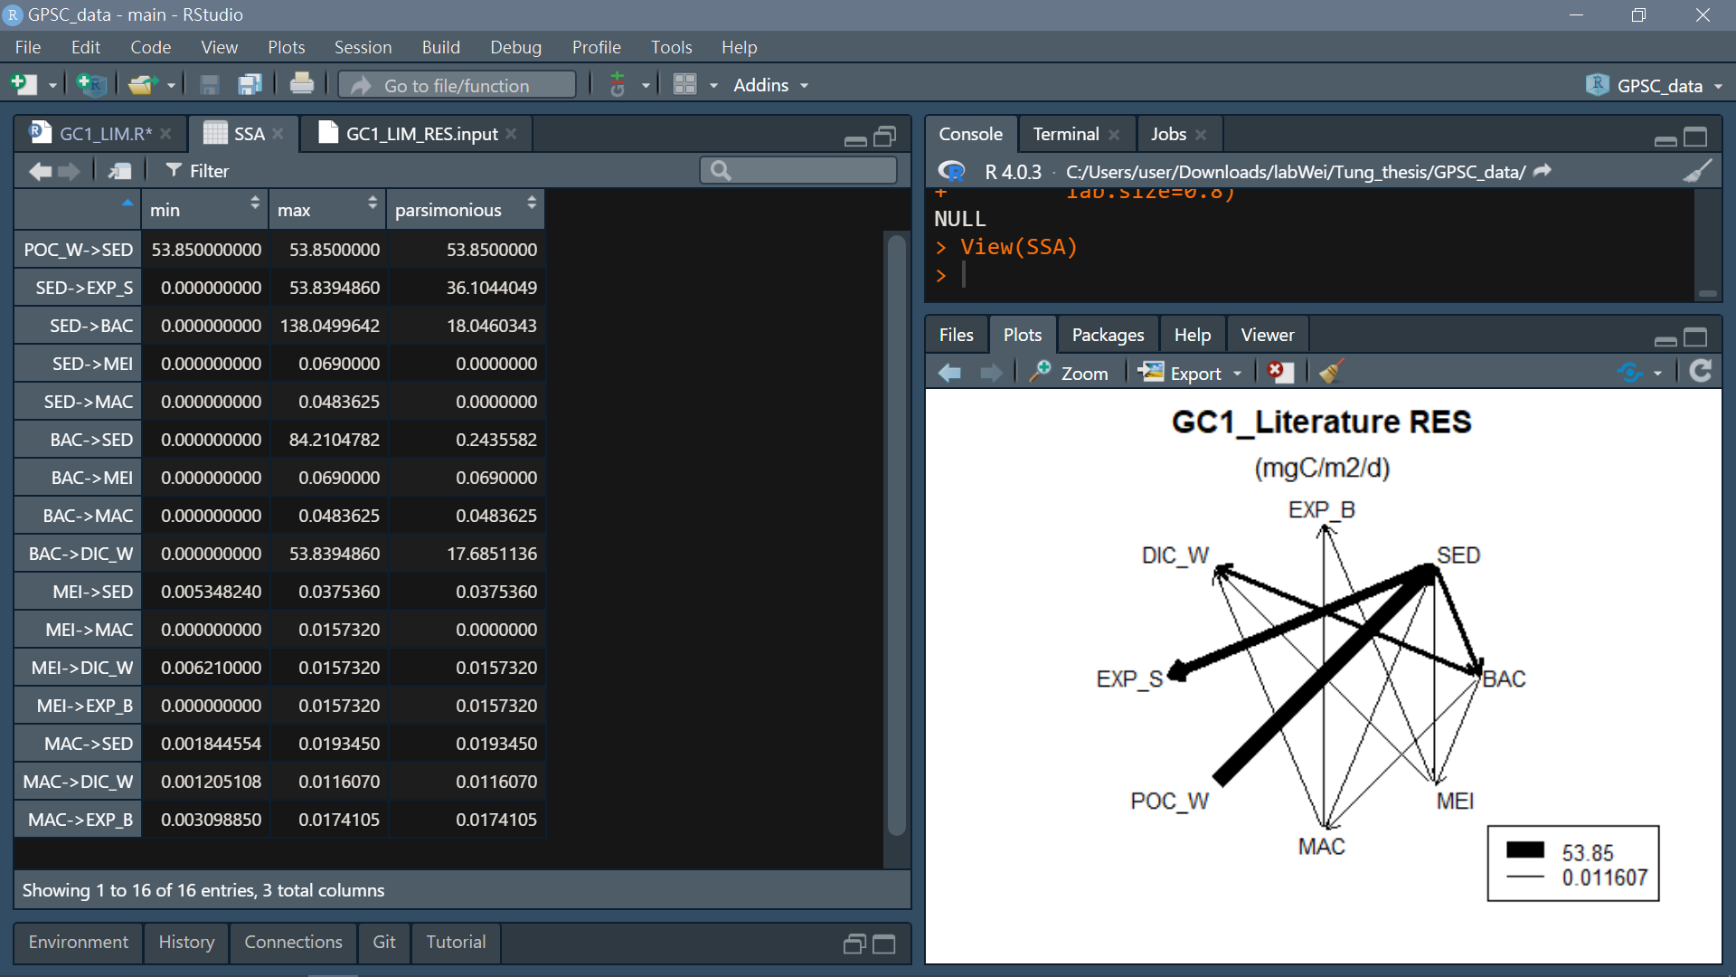
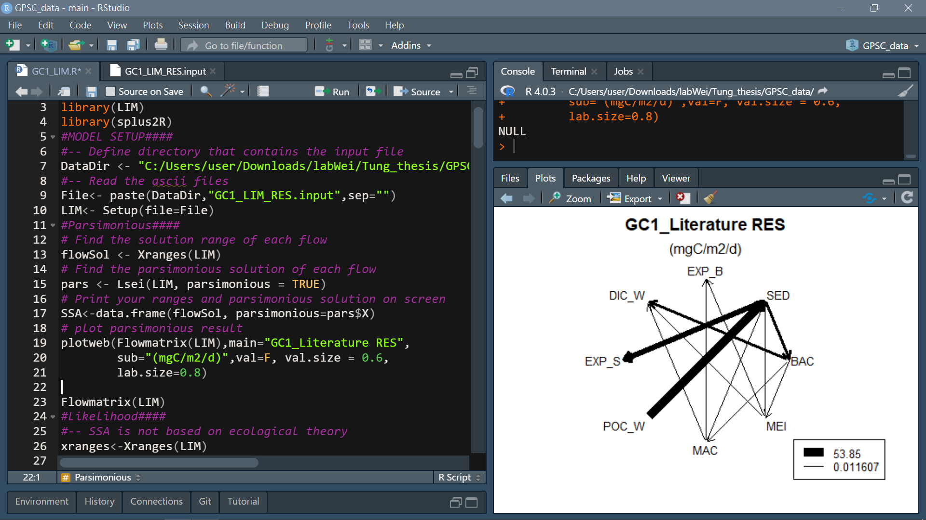
SSA Result:

Slide 28
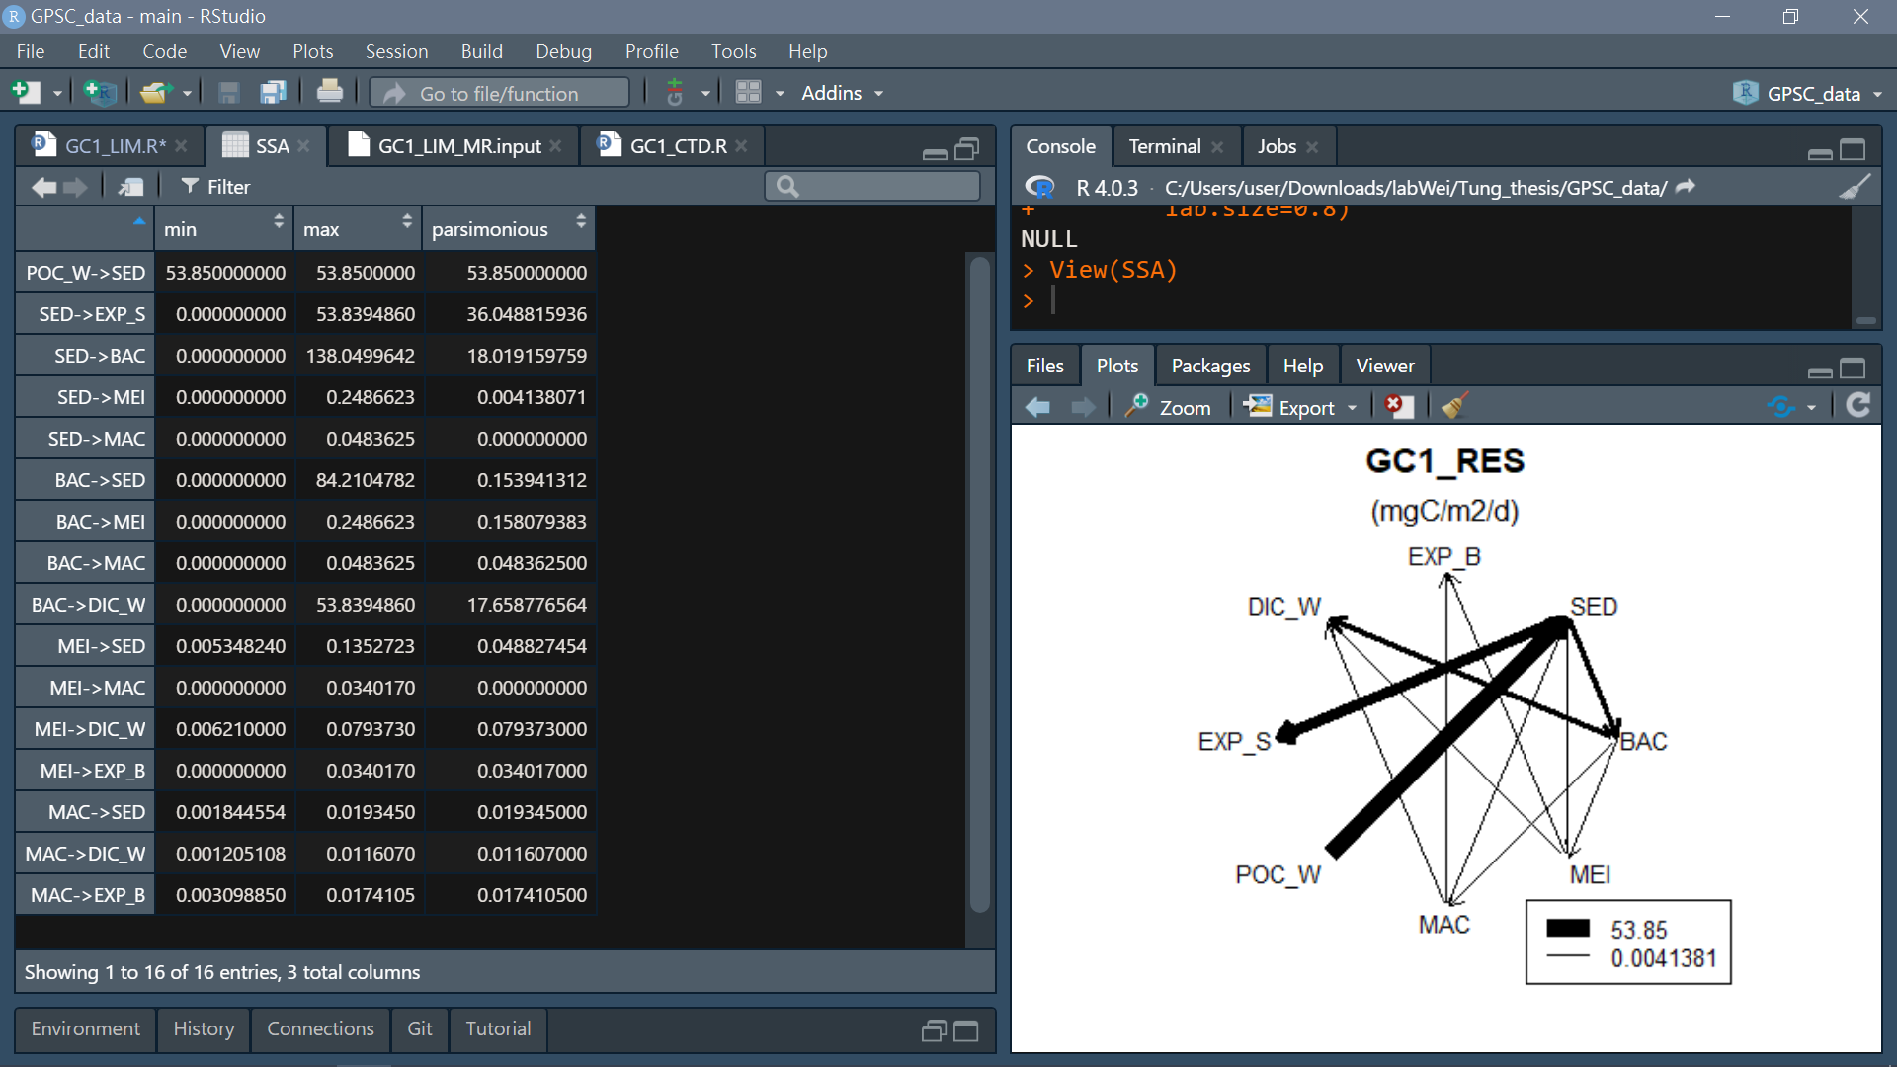
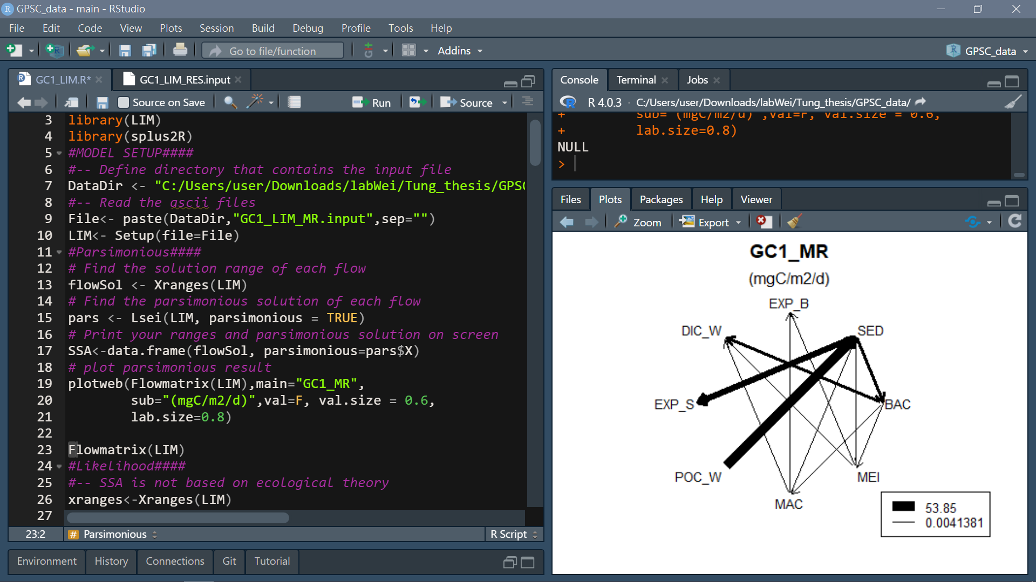
SSA Result:
Station | Bottom water temperature(°C) | Tlim
GC1 | 13.54 | 1.05
GS1 | 13.86 | 1.08
Tlim = Q10* exp((T-20)/10), with Q10 = 2

Slide 29
Before compare results from different methods
if the number of iterations is high enough to produces convergence of the mean and the standard deviation
standard deviation < 2%
Check at least 3 different magnitude flows
if the range of sampled values cover the range of possible solutions
>75% of the flows has a sampled range of >75% of the solution range
Iteration=10000; jumpsize=100

Slide 30
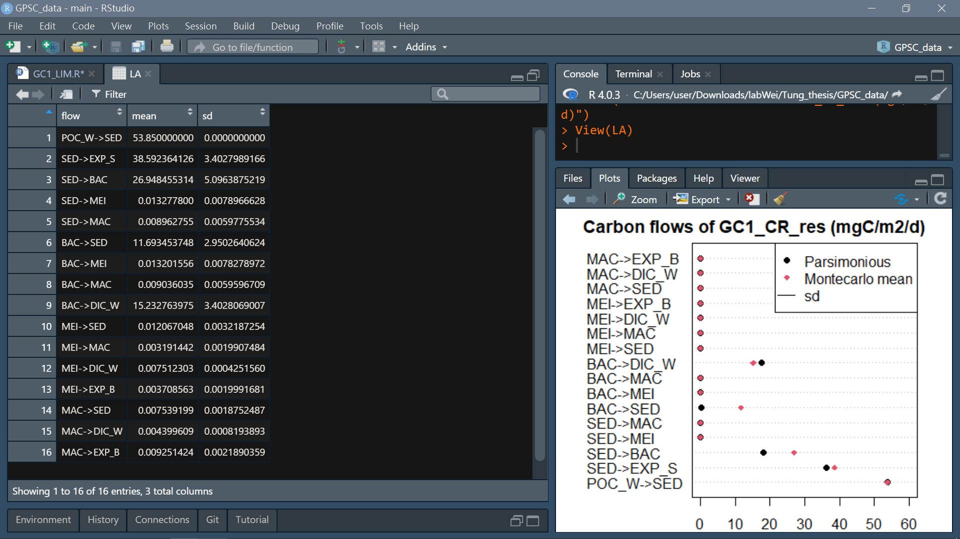
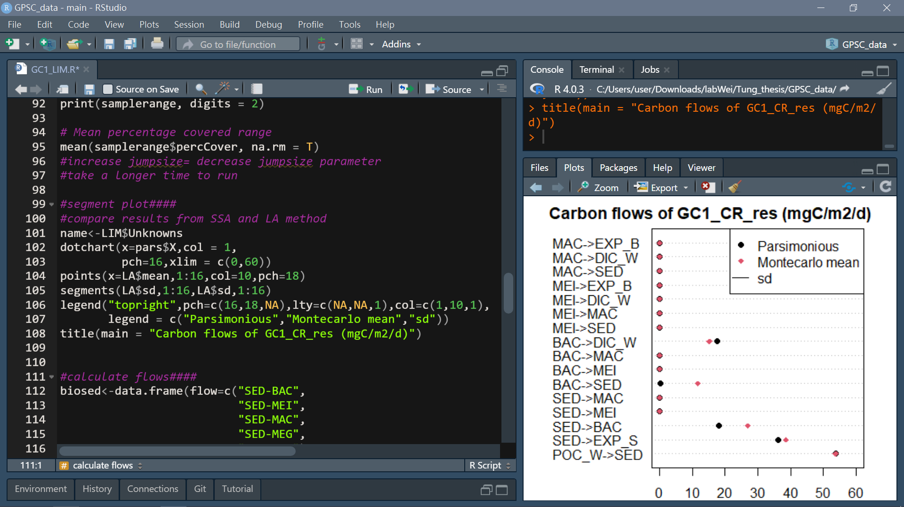
LA Result:

Slide 31
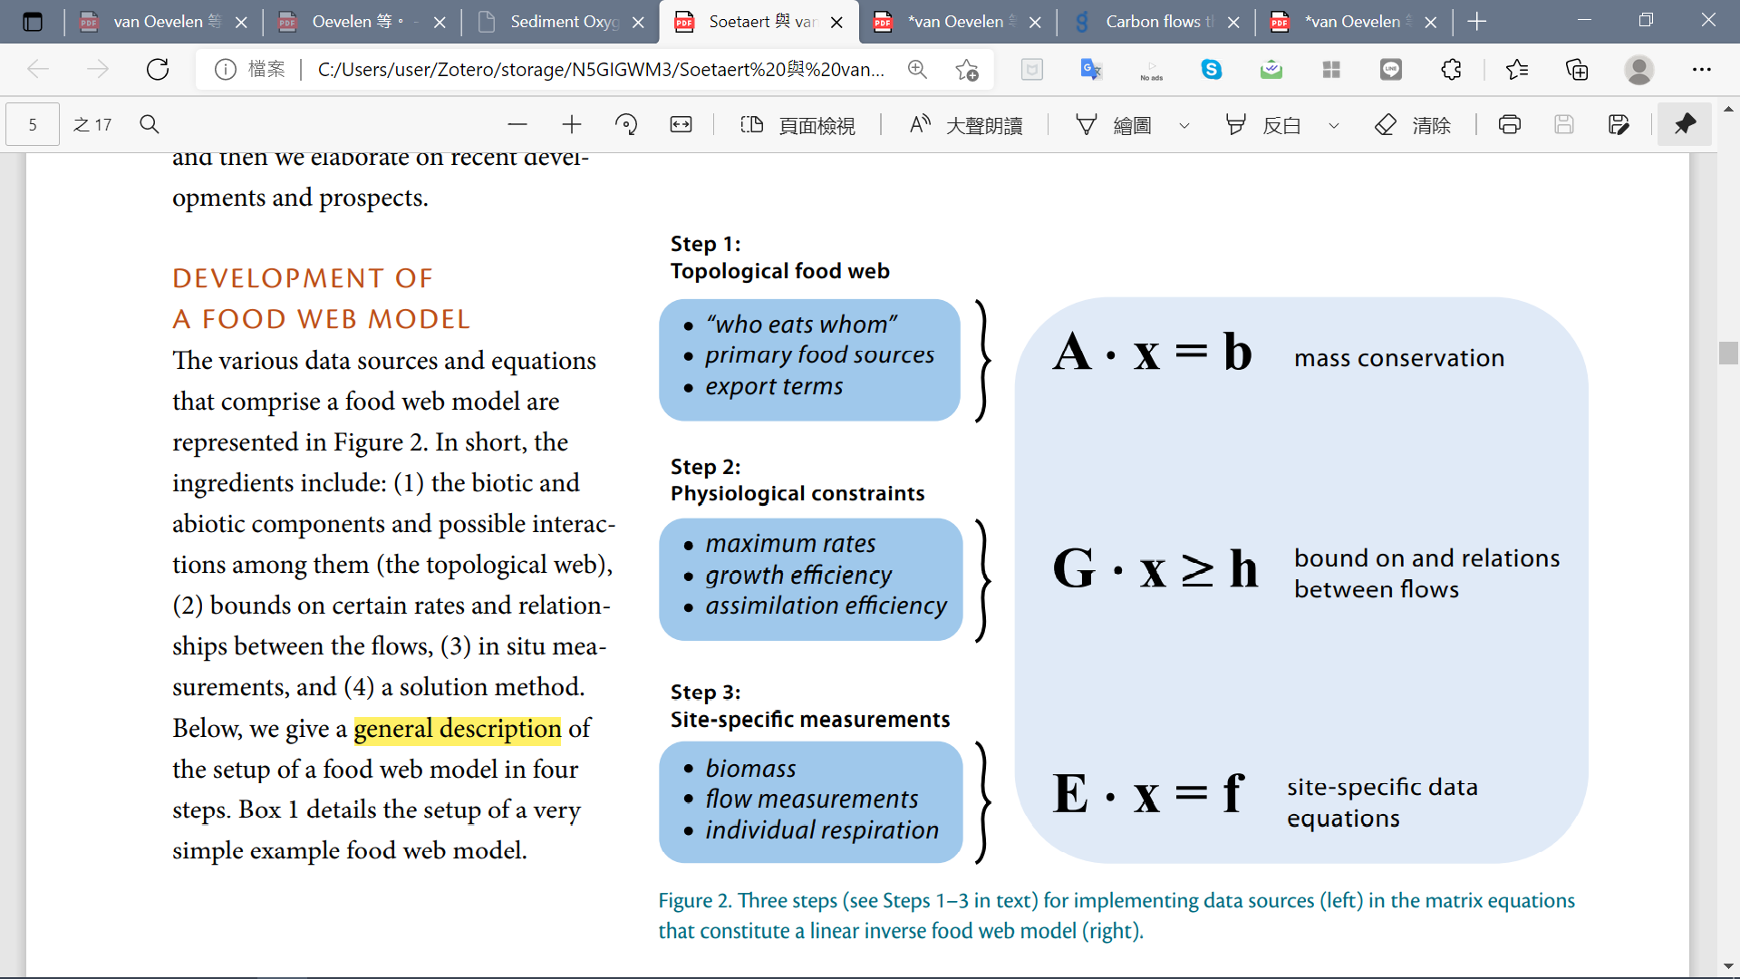
Development of a linear inverse model

Slide 32
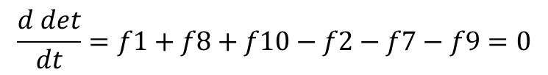
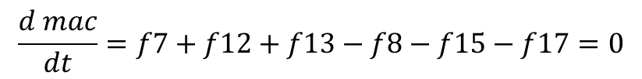
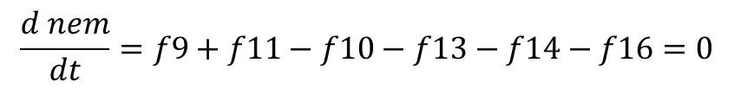
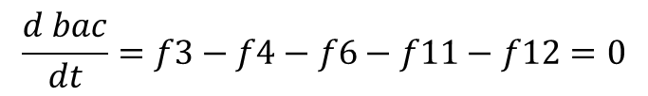
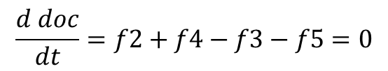
Development of a linear inverse model
det_w
doc_w
dic_w
f1
f5
f6
f15
det
f14
$$\frac{d det}{dt}=f1+f8+f10−f2−f7−f9=0$$
f10
f2
f9
f7
$$\frac{d doc}{dt}=f2+f4−f3−f5=0$$
doc
nem
f16
exp
$$\frac{d bac}{dt}=f3−f4−f6−f11−f12=0$$
f4
f3
f13
f17
f11
f8
$$\frac{d nem}{dt}=f9+f11−f10−f13−f14−f16=0$$
bac
mac
f12
$$\frac{d mac}{dt}=f7+f12+f13−f8−f15−f17=0$$
All mass balances are assumed to be in steady state

Slide 33
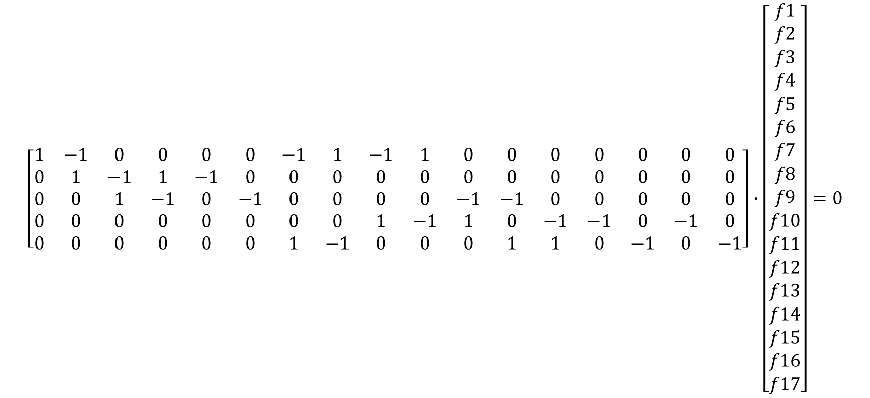
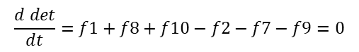
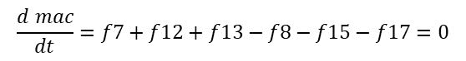
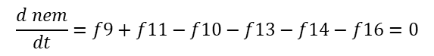


Development of a linear inverse model
$$\frac{d det}{dt}=f1+f8+f10−f2−f7−f9=0$$
$$\frac{d doc}{dt}=f2+f4−f3−f5=0$$
$$\frac{d bac}{dt}=f3−f4−f6−f11−f12=0$$
x
$$\frac{d nem}{dt}=f9+f11−f10−f13−f14−f16=0$$
$$\left[\begin{matrix}\begin{matrix}\begin{matrix}\begin{aligned}1 \\ 0 \\ 0 \\ 0 \\ 0\end{aligned} & \begin{aligned}−1 \\ 1 \\ 0 \\ 0 \\ 0\end{aligned} & \begin{aligned}0 \\ −1 \\ 1 \\ 0 \\ 0\end{aligned}\end{matrix} & \begin{aligned}0 \\ 1 \\ −1 \\ 0 \\ 0\end{aligned} & \begin{aligned}0 \\ −1 \\ 0 \\ 0 \\ 0\end{aligned}\end{matrix} & \begin{matrix}\begin{aligned}0 \\ 0 \\ −1 \\ 0 \\ 0\end{aligned} & \begin{aligned}−1 \\ 0 \\ 0 \\ 0 \\ 1\end{aligned} & \begin{aligned}1 \\ 0 \\ 0 \\ 0 \\ −1\end{aligned}\end{matrix} & \begin{matrix}\begin{aligned}−1 \\ 0 \\ 0 \\ 1 \\ 0\end{aligned} & \begin{aligned}1 \\ 0 \\ 0 \\ −1 \\ 0\end{aligned} & \begin{matrix}\begin{aligned}0 \\ 0 \\ −1 \\ 1 \\ 0\end{aligned} & \begin{aligned}0 \\ 0 \\ −1 \\ 0 \\ 1\end{aligned} & \begin{matrix}\begin{aligned}0 \\ 0 \\ 0 \\ −1 \\ 1\end{aligned} & \begin{aligned}0 \\ 0 \\ 0 \\ −1 \\ 0\end{aligned} & \begin{matrix}\begin{aligned}0 \\ 0 \\ 0 \\ 0 \\ −1\end{aligned} & \begin{aligned}0 \\ 0 \\ 0 \\ −1 \\ 0\end{aligned} & \begin{aligned}0 \\ 0 \\ 0 \\ 0 \\ −1\end{aligned}\end{matrix}\end{matrix}\end{matrix}\end{matrix}\end{matrix}\right]∙\left[\begin{aligned}f1 \\ f2 \\ f3 \\ f4 \\ f5 \\ f6 \\ f7 \\ f8 \\ f9 \\ f10 \\ f11 \\ f12 \\ f13 \\ f14 \\ f15 \\ f16 \\ f17\end{aligned}\right]=0$$
$$\frac{d mac}{dt}=f7+f12+f13−f8−f15−f17=0$$
A
b
All mass balances are assumed to be in steady state (i.e. b=0)

Slide 34
細分食性:改structure
Assume:
influx POC as a complex assemblage of, while a portion of sediment flows out the system through the process of burial and/or export (orange flows). Then, it is assumed that bacteria feed only on detrital OC; meiofauna feeds on bacteria and detrital OC; macrofauna feeds on meiofauna, bacteria and detrital OC. Then, the meiofauna will be further divided into selective deposit feeders, non-selective deposit feeders, epigrowth feeders, and omnivores/predators (Liao et al., 2020), and the macrofauna stocks will be divided into surface deposit-feeders, deposit-feeders, suspension-feeders, and predators+scavengers (Chen, 2018). Moreover, it is presumed that the predators of each size class prey on organisms of the same and smaller size classes. The grey flows indicate the loss of carbon as the feces and as consumed by benthopelagic/pelagic predators (fig. 12). In this LIM model, the compartments with orange color are part of the food web model, whereas compartments with blue color were only considered as carbon influx or efflux, but were not directly modeled.

